Slide 1

CSE-2211
Database Management System Lab

Slide 2
Presented To
Abu Ahmed Ferdaus
Associate Professor
Department of Computer Science & Engineering
University of Dhaka

Slide 3
Presented To
Dr. Md Mamun-Or-Rashid
Professor
Department of Computer Science & Engineering
University of Dhaka

Slide 4
Presented By
Md. Tauseef - Ur - Rahman (Roll 24)
Faiaz Mahmud (Roll 46)
28th Batch

Slide 5
Project Name
Shop Management System

Slide 6

Brief Overview
The Shop Management System is a database-driven application designed to efficiently manage retail operations using structured queries. The system relies on SQL queries to handle core functionalities such as user authentication, product management, order processing, and billing

Slide 7
Tools Used In Our Project

Slide 8
Frontend Tools
Backend Tools
Next.js 14 (React)
TypeScript
Tailwind CSS
Tremor (for charts and analytics)
Lucid Icons
Node.js
Express.js
PostgreSQL Database

Slide 9
Schemas with Attributes
Users (users)
Products (product)
Workers (worker)
user_id (INT, PK) – Unique ID.
user_name (VARCHAR(50)) – Name.
user_email (VARCHAR(50)) – Unique Email.
user_password (VARCHAR(255)) – Password.
user_contact_no (VARCHAR(20)) – Contact number.
is_admin (BOOLEAN) – Admin status.
prod_id (INT, PK) – Unique product ID.
prod_name (VARCHAR(255)) – Name.
prod_image (VARCHAR(255)) – Image URL.
prod_quantity (INT) – Stock quantity.
prod_price (DECIMAL(10,2)) – Price.
rating_stars (INT) – Rating.
prod_discount (DECIMAL(5,2)) – Discount.
worker_id (INT, PK) – Unique ID.
worker_name (VARCHAR(50)) – Name.
worker_email (VARCHAR(50)) – Unique Email.
worker_contact_no (VARCHAR(20)) – Contact number.
worker_salary (DOUBLE) – Salary.

Slide 10
Schemas with Attributes
Shopping Cart (shopping_cart)
Orders (orders)
Order Details (order_detail)
order_id (INT, PK) – Unique order ID.
order_date (DATE) – Date.
user_id (INT, FK) – User who ordered.
delivery_address (VARCHAR(50)) – Delivery address.
total_amt (DECIMAL(10,2)) – Order total.
order_status (VARCHAR(20)) – Status.
order_id (INT, FK) – Order ID.
prod_id (INT, FK) – Product ID.
prod_qty (INT) – Quantity.
prod_price (DOUBLE) – Price.
prod_total_price (DOUBLE) – Total price.
cart_id (INT, PK) – Unique cart ID.
prod_id (INT, FK) – Product ID.
user_id (INT, FK) – User ID.

Slide 11
Schemas with Attributes
Billing (bill_detail)
Order Returns (order_return)
order_return_id (INT, PK) – Unique return ID.
order_id (INT, FK) – Order ID.
user_id (INT, FK) – User ID.
return_date (TIMESTAMP) – Return date.
prod_id (INT, FK) – Product ID.
return_amount (DOUBLE) – Refund amount.
bill_id (INT, PK) – Unique bill ID.
bill_date (DATE) – Date.
user_id (INT, FK) – User ID.
order_id (INT, FK) – Order ID.
order_total_price (DECIMAL(10,2)) – Order total.
bill_total_price (DECIMAL(10,2)) – Final bill amount (after adding discounts).
pay_status (VARCHAR(20)) – Payment status.

Slide 12
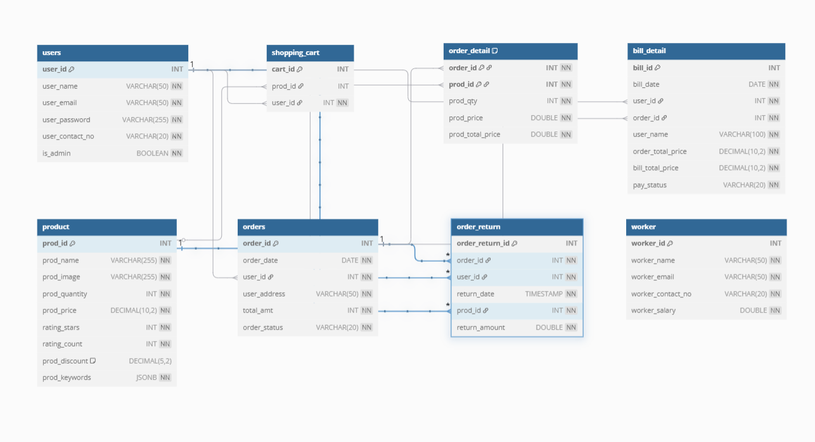
Schema Diagram

Slide 13
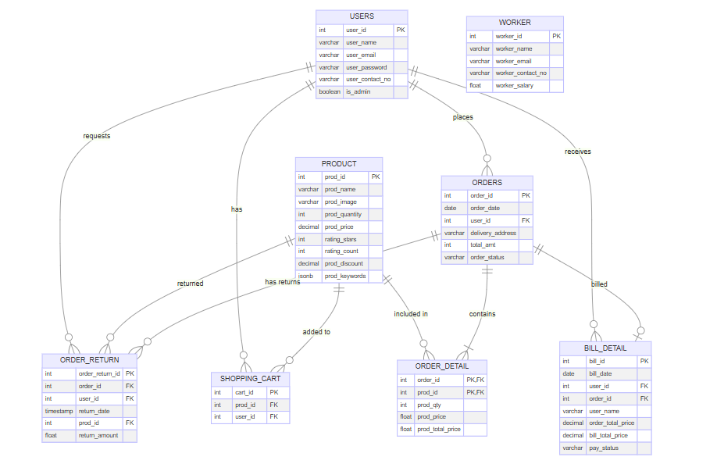
ER Diagram
1
1
1
1
M
1
M
M
1
1
M
1
M
M
1
M
M
M
M
M
1
1

Slide 14
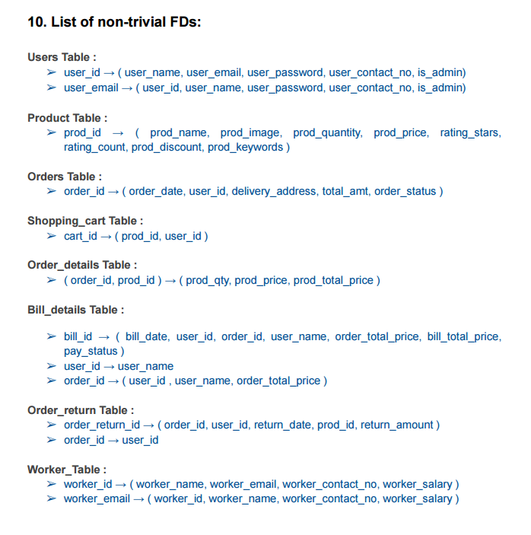

Slide 15
Normal Form of the Schemas
Normal Forms
 | 1NF | 2NF | 3NF | BCNF
Users | Yes | Yes | Yes | Yes
Product | Yes | Yes | Yes | Yes
Workers | Yes | Yes | Yes | Yes
Orders | Yes | Yes | Yes | Yes
Order Details | Yes | Yes | Yes | Yes
Order Return | Yes | Yes | Yes | Yes
Bill details | Yes | Yes | No | No
Shopping Cart | Yes | Yes | Yes | Yes
Schemas

Slide 16
Some Snapshots of our Web Application

Slide 17
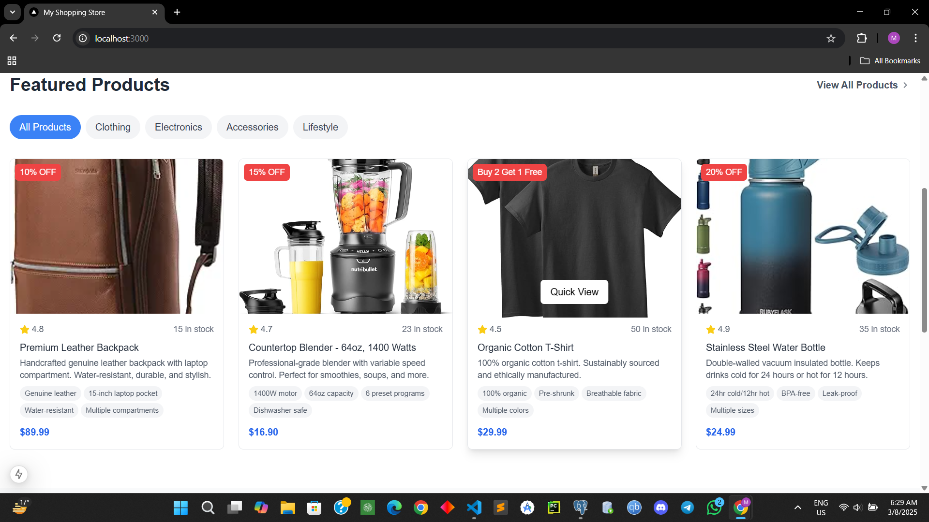
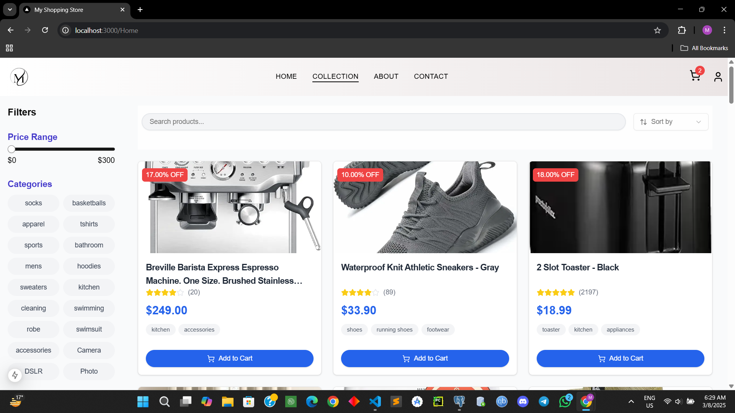
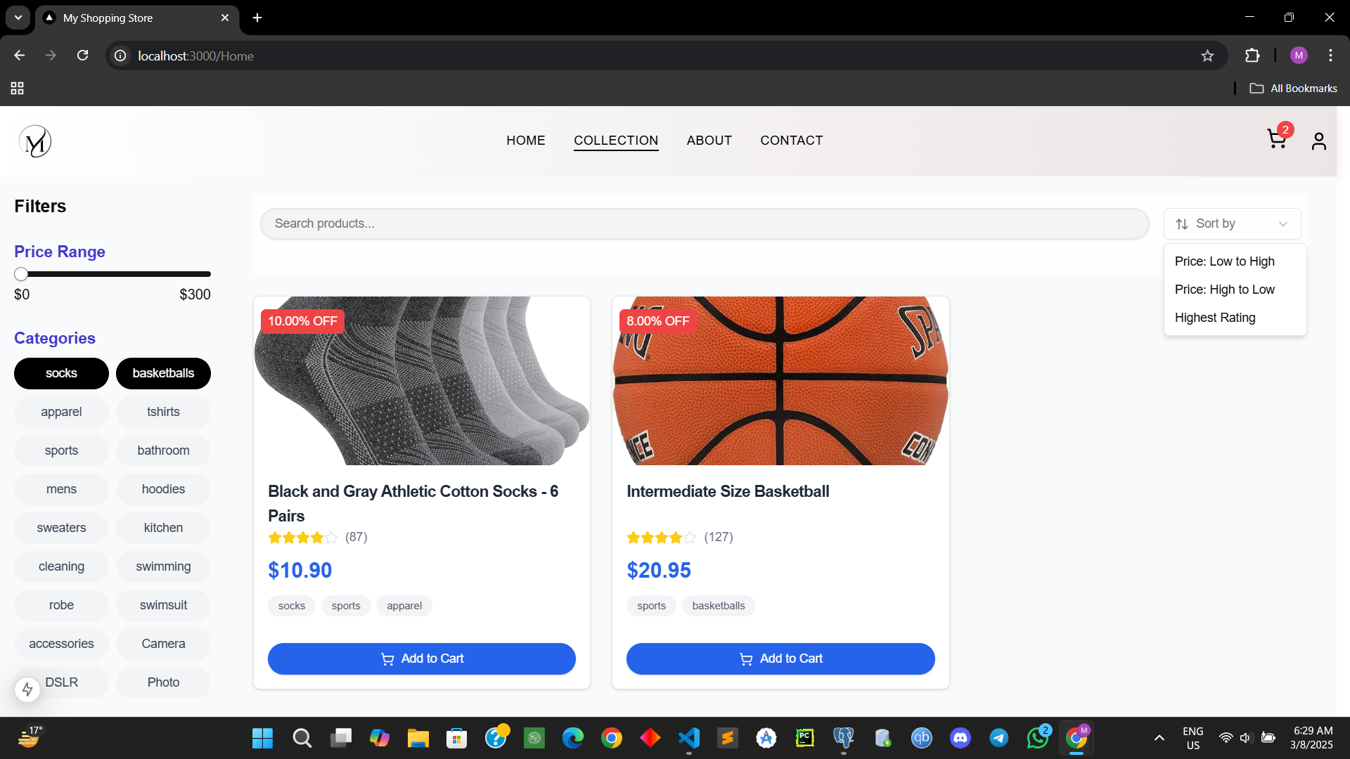
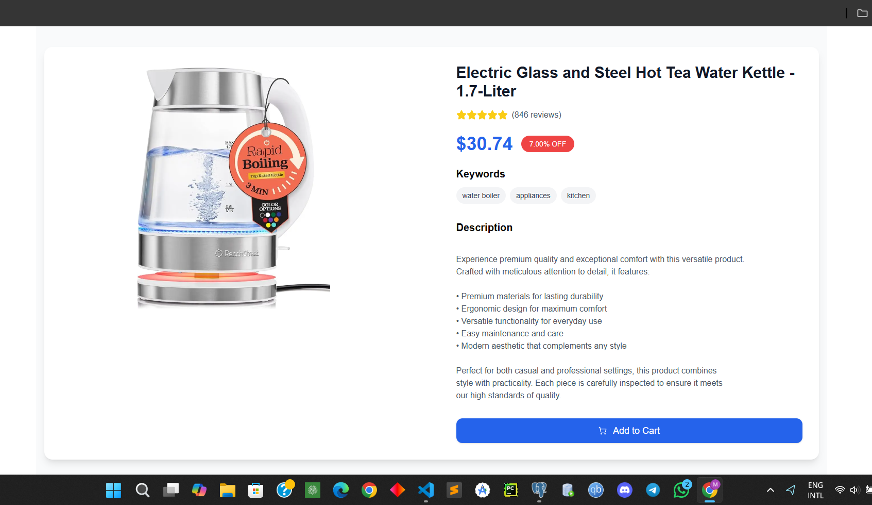

Slide 18
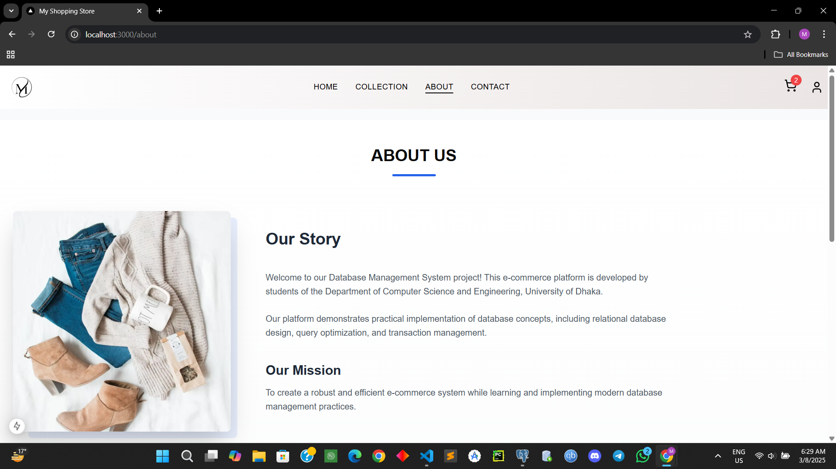
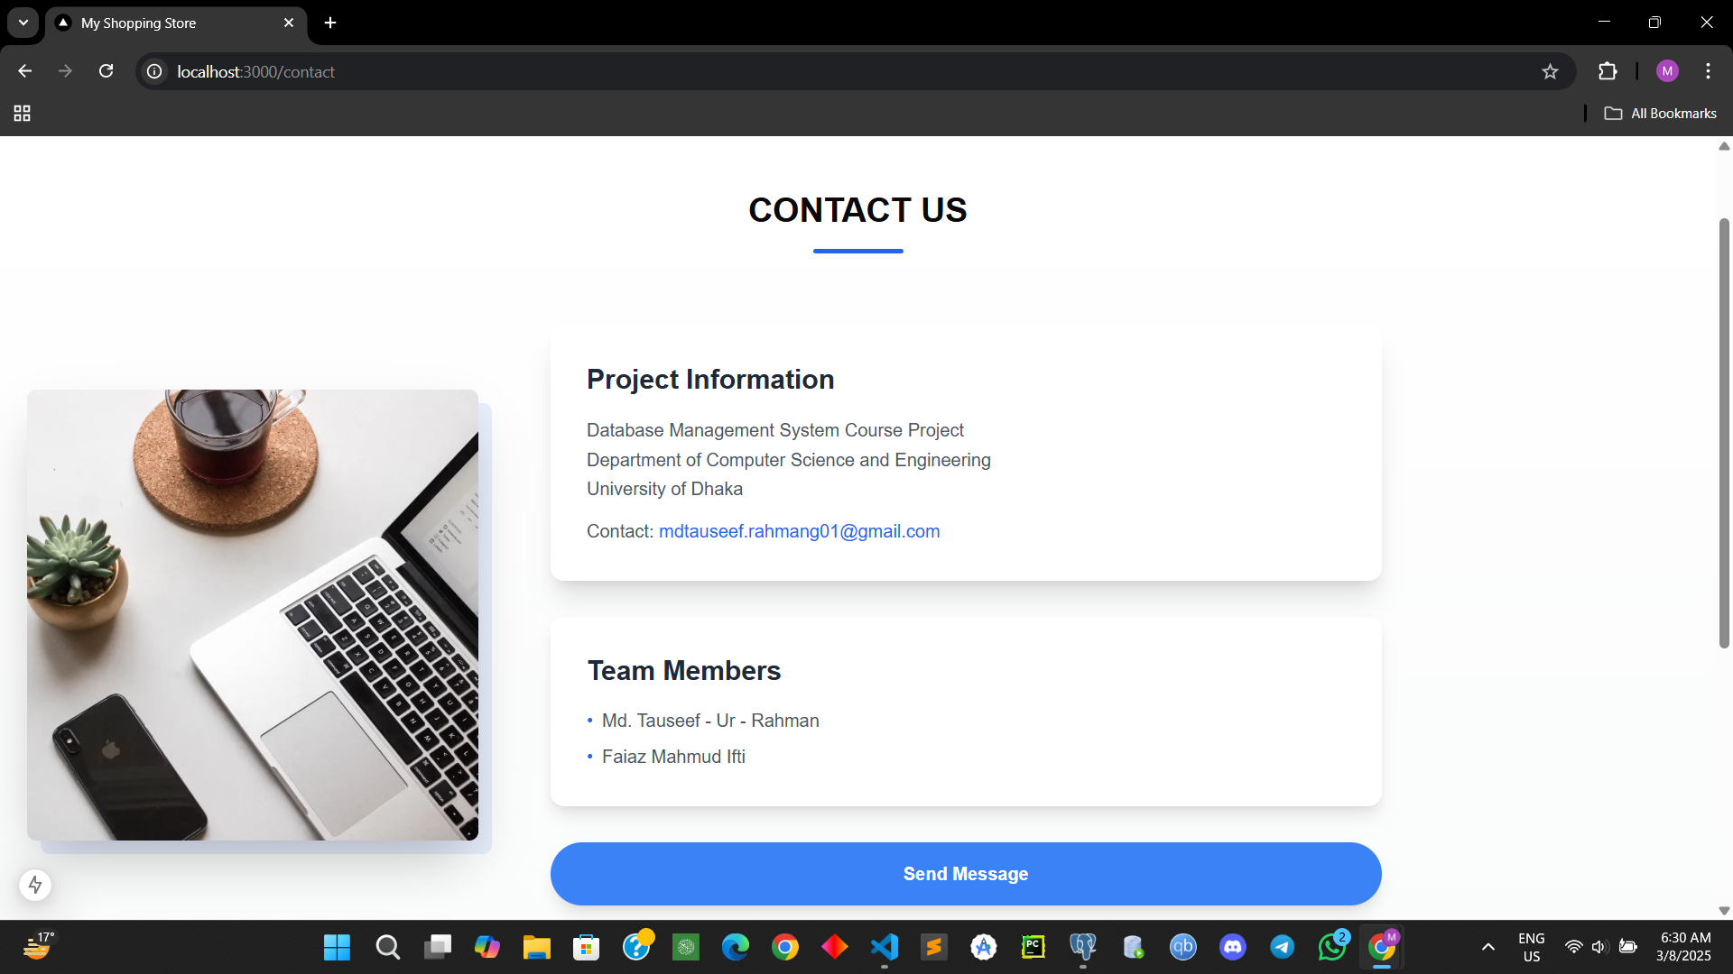
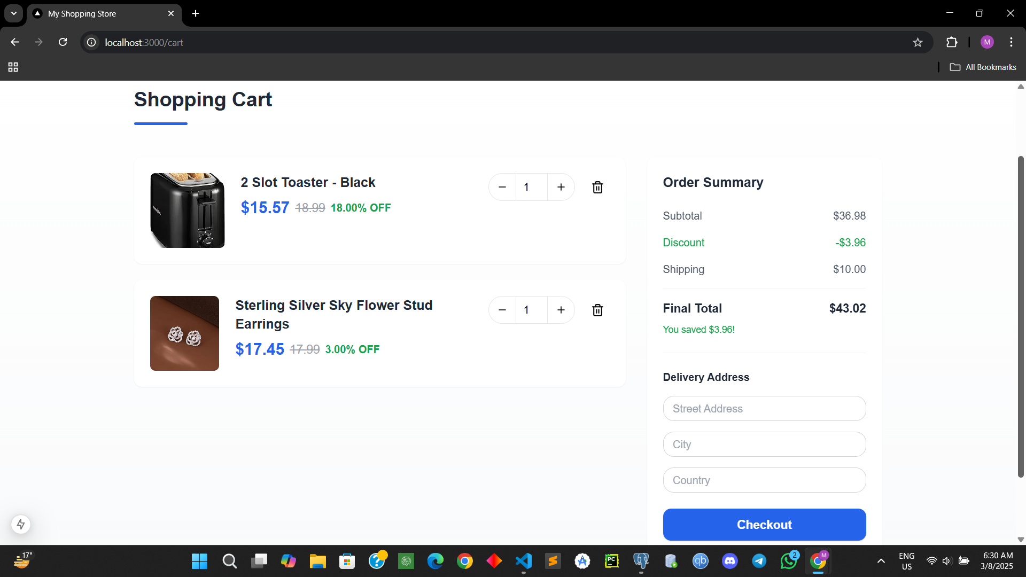
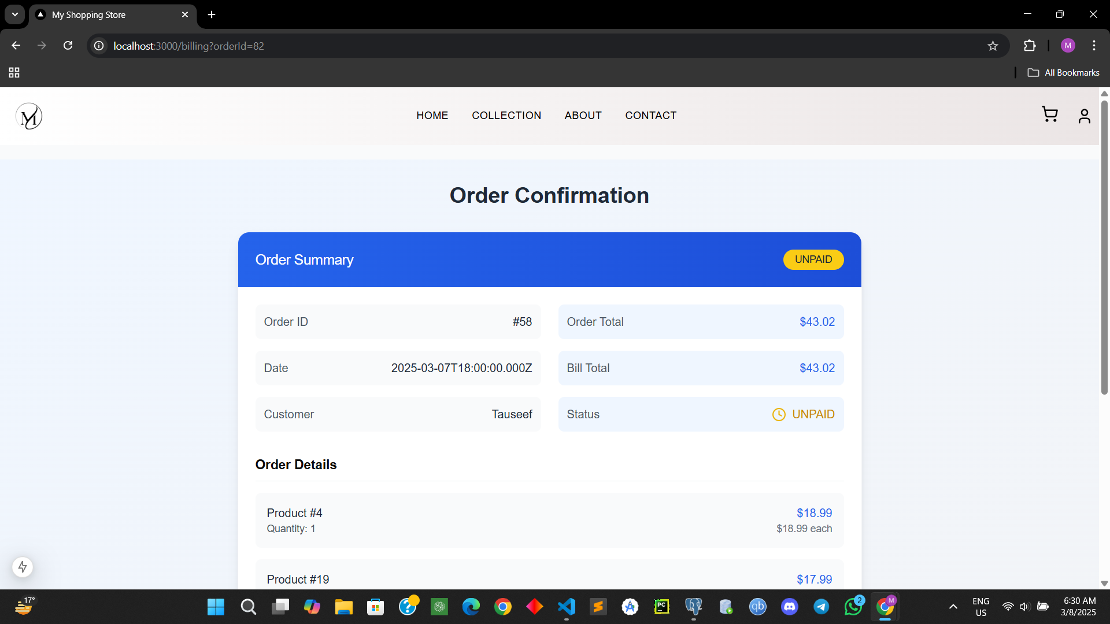

Slide 19
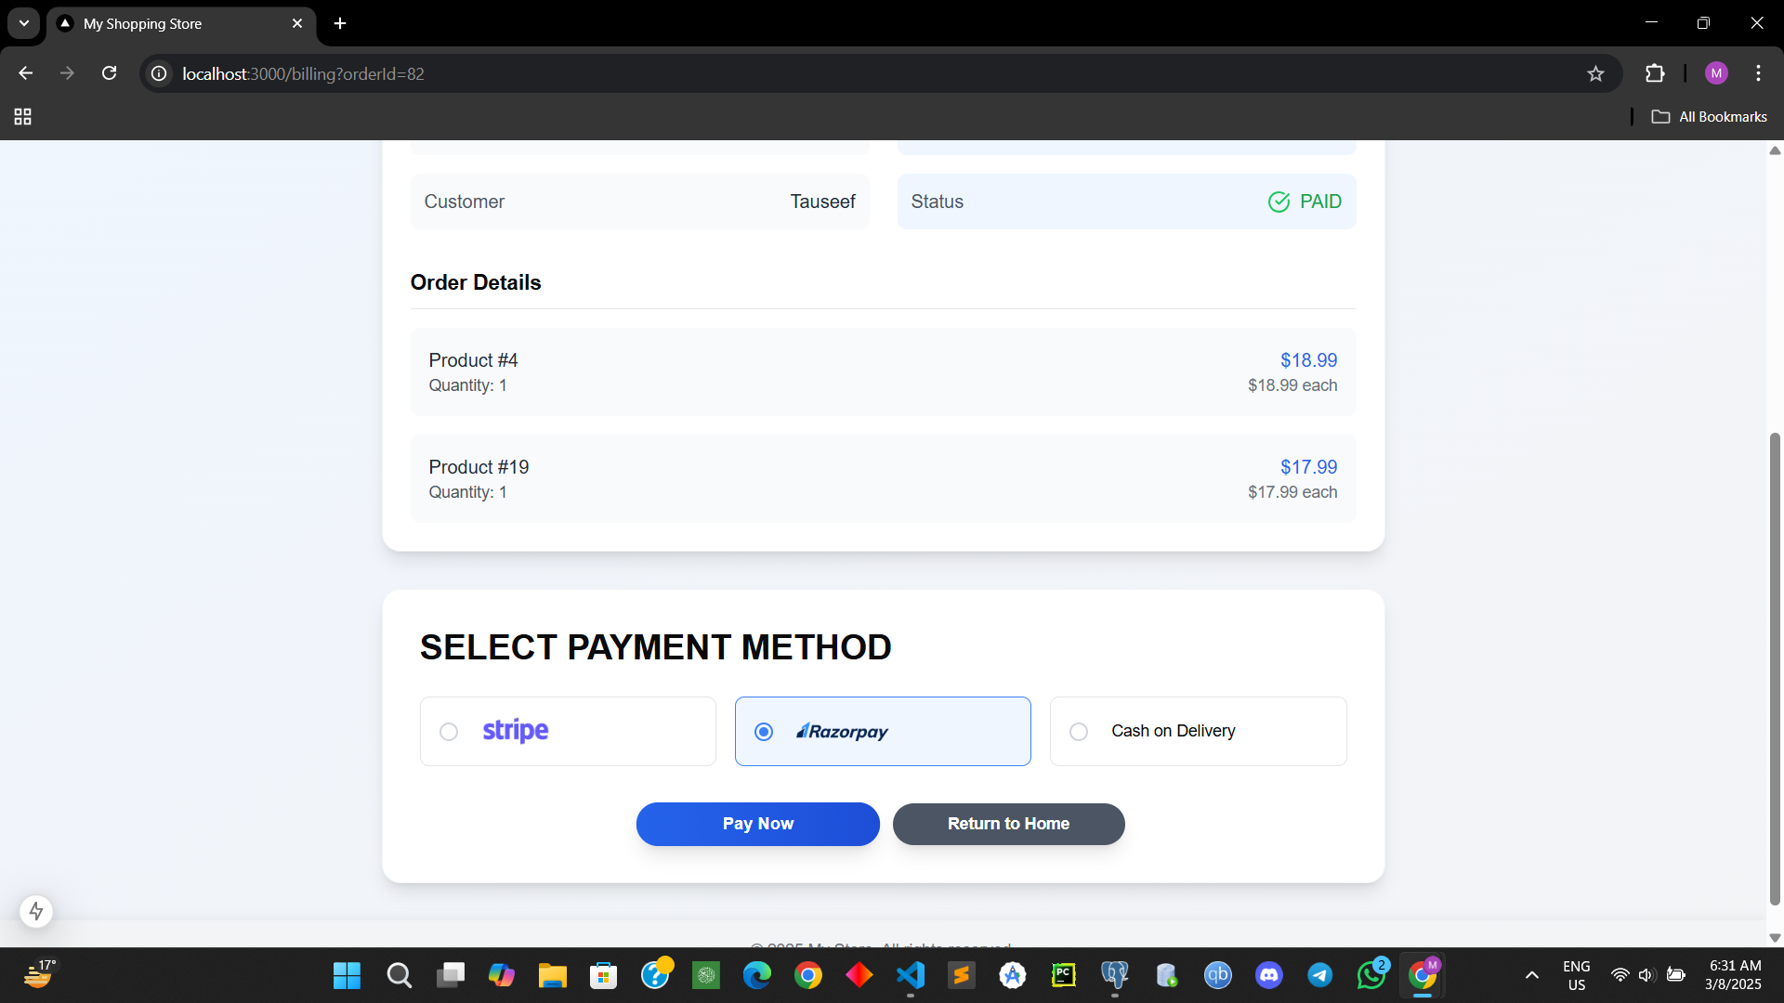
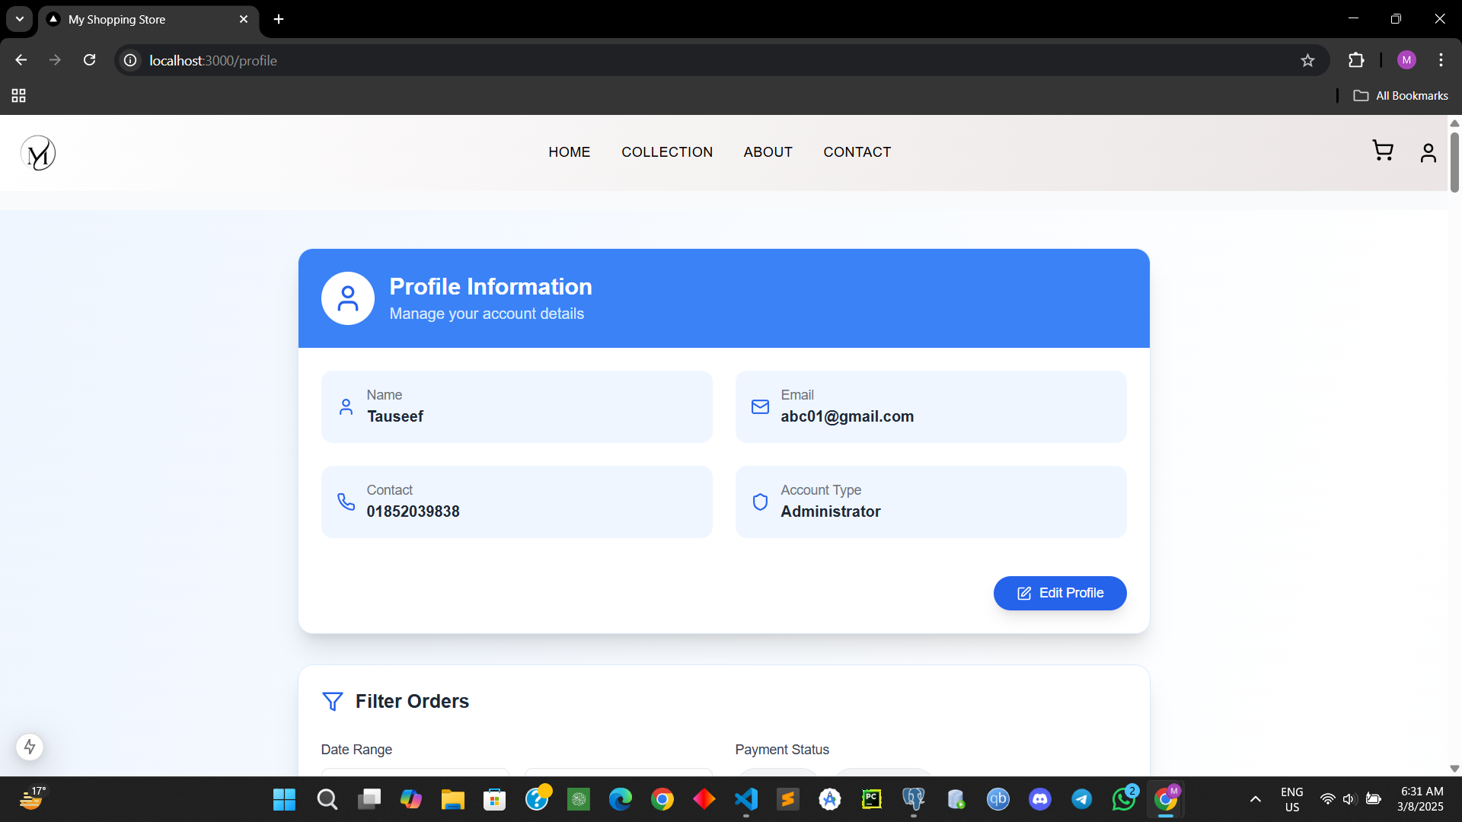
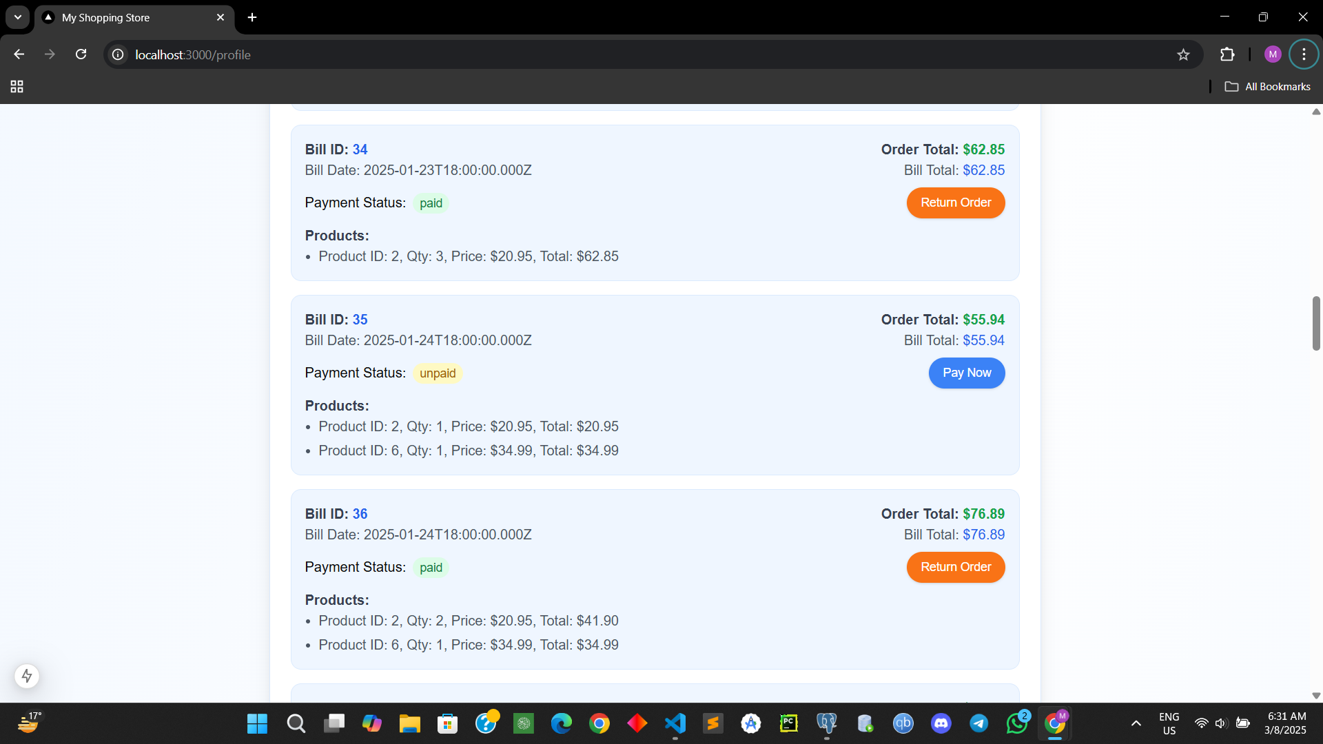
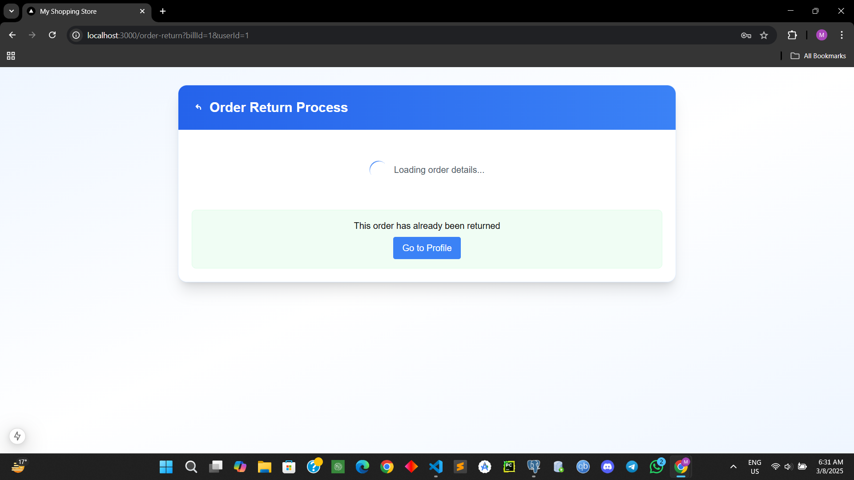

Slide 20
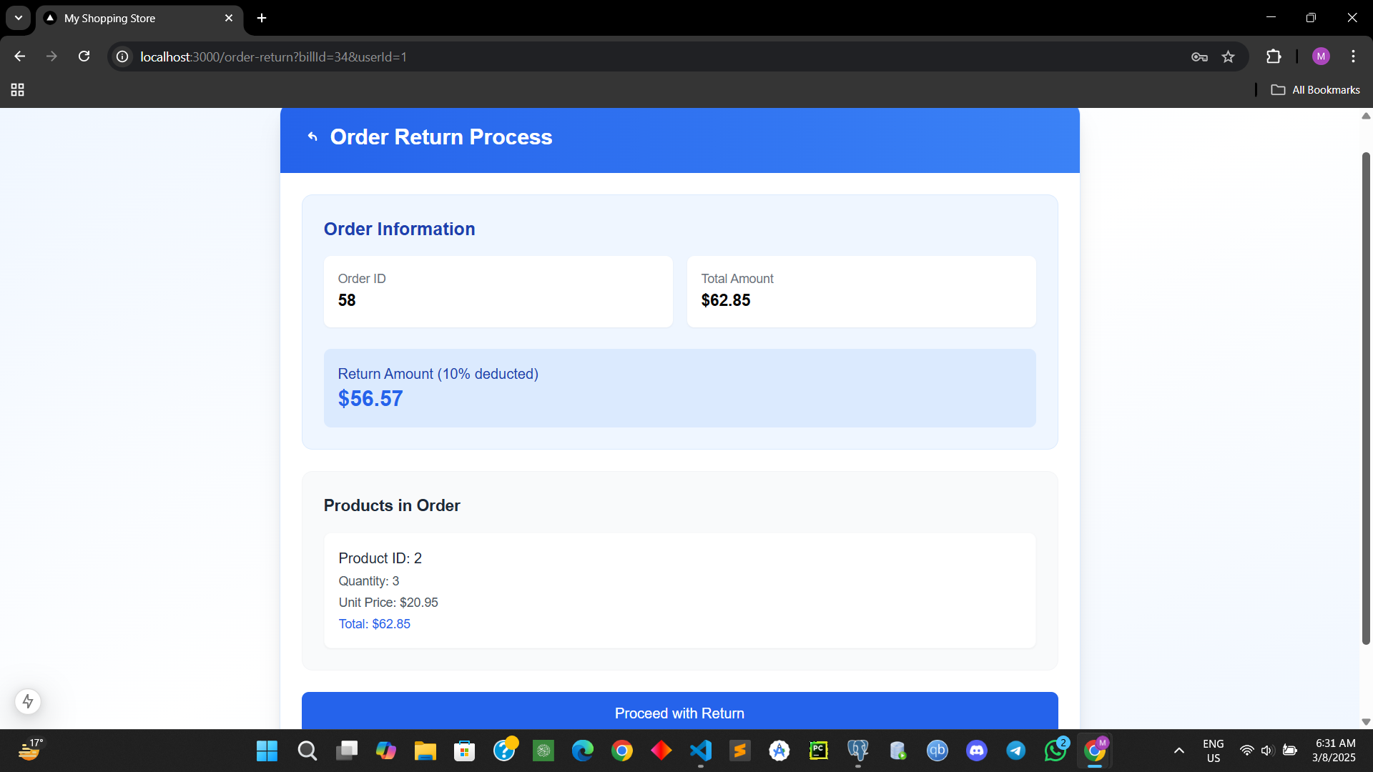
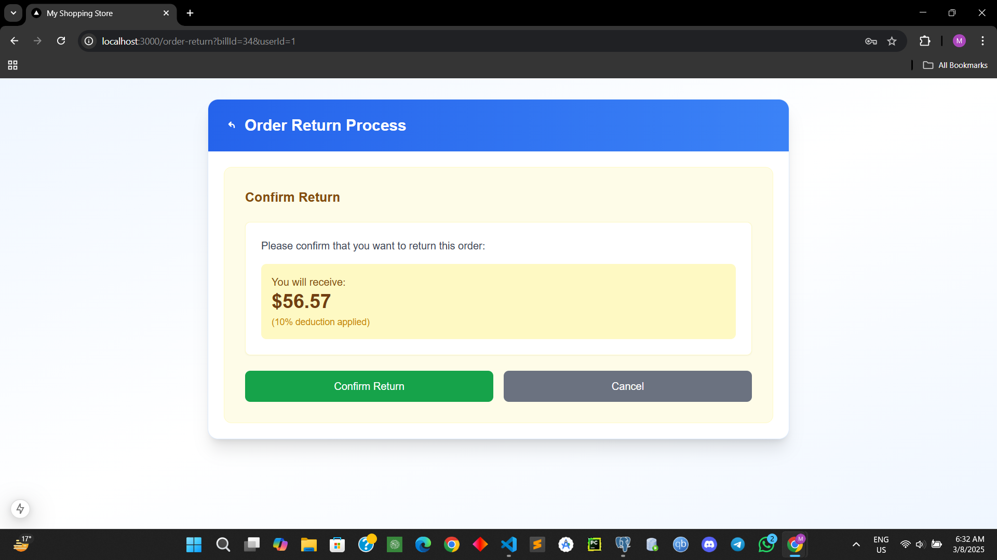
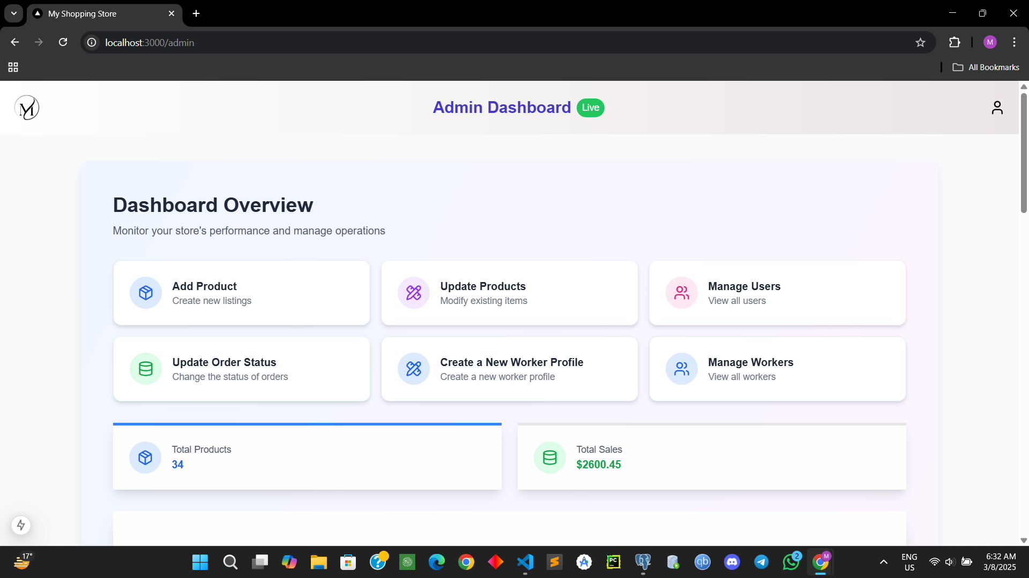
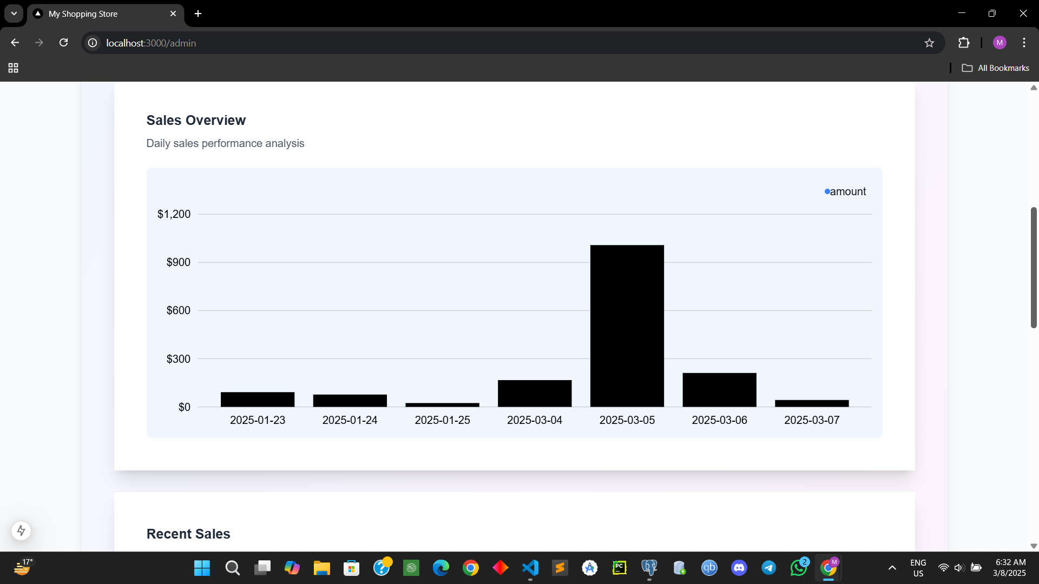

Slide 21
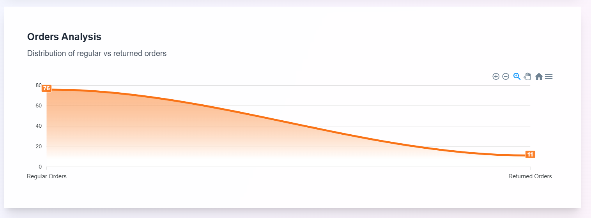
Distribution of regular vs returned orders

Slide 22
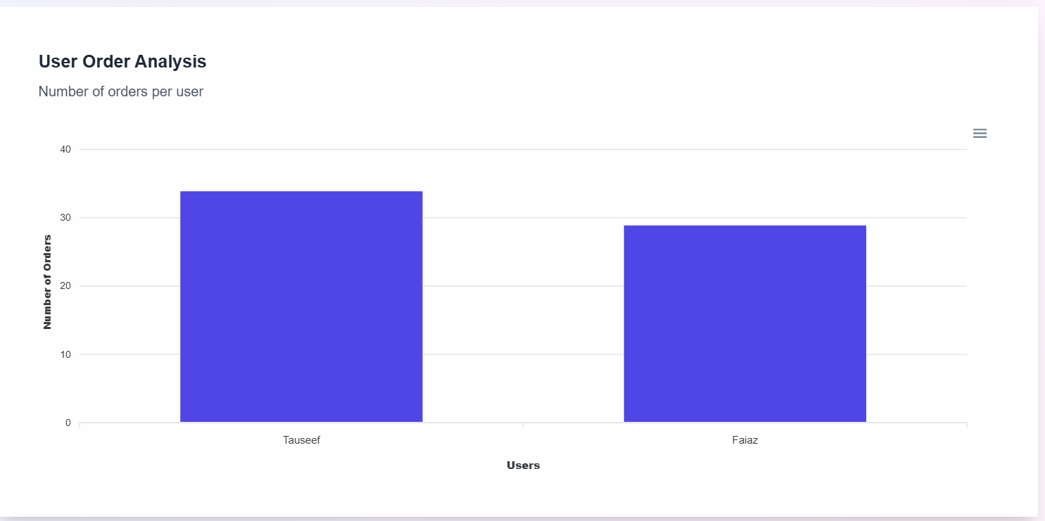
Overview of no of orders per user

Slide 23
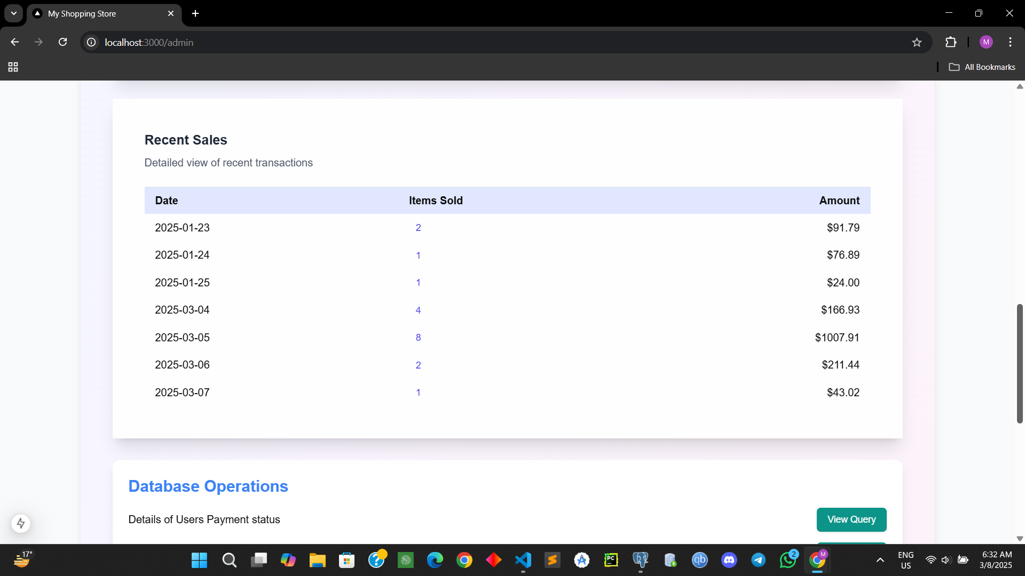
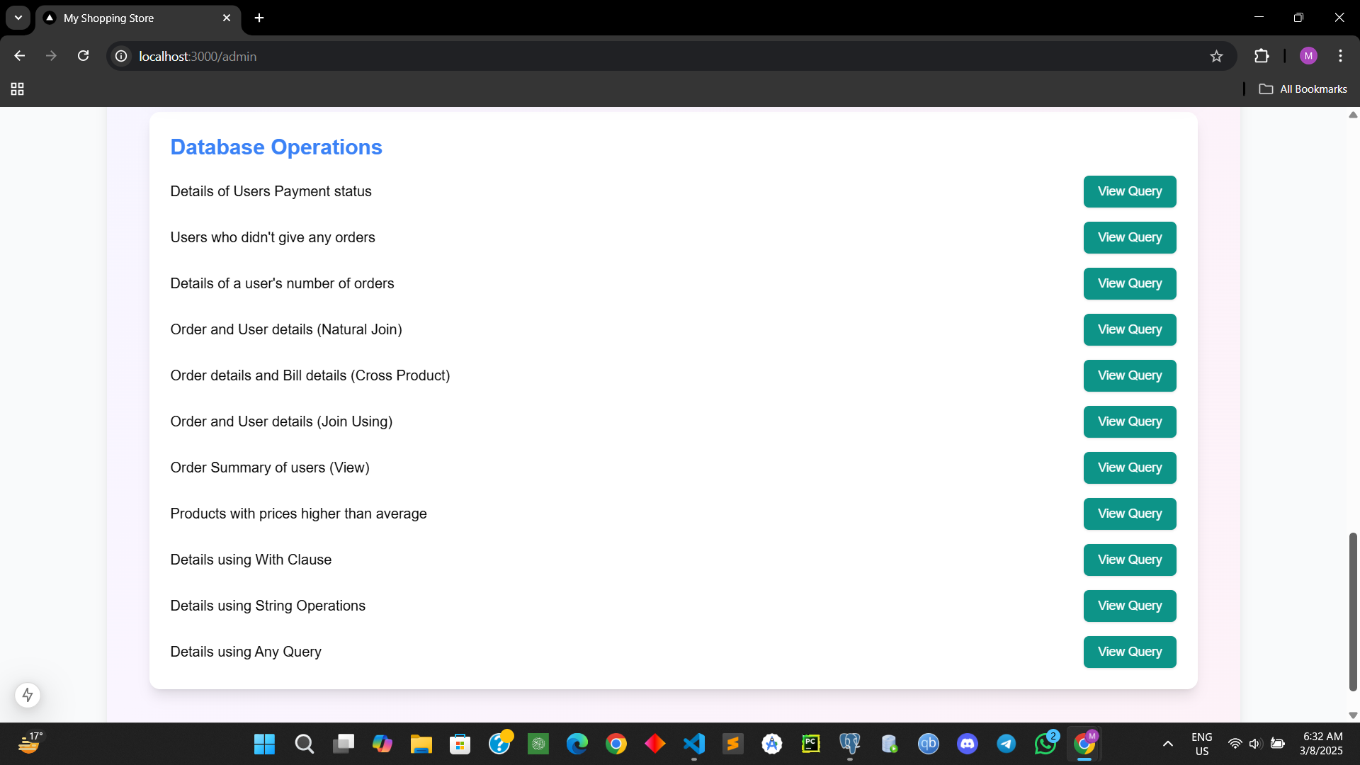
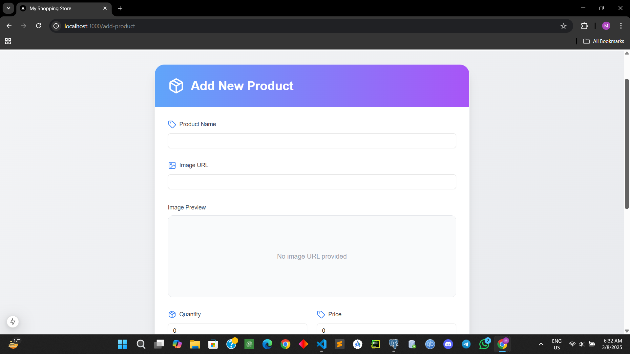
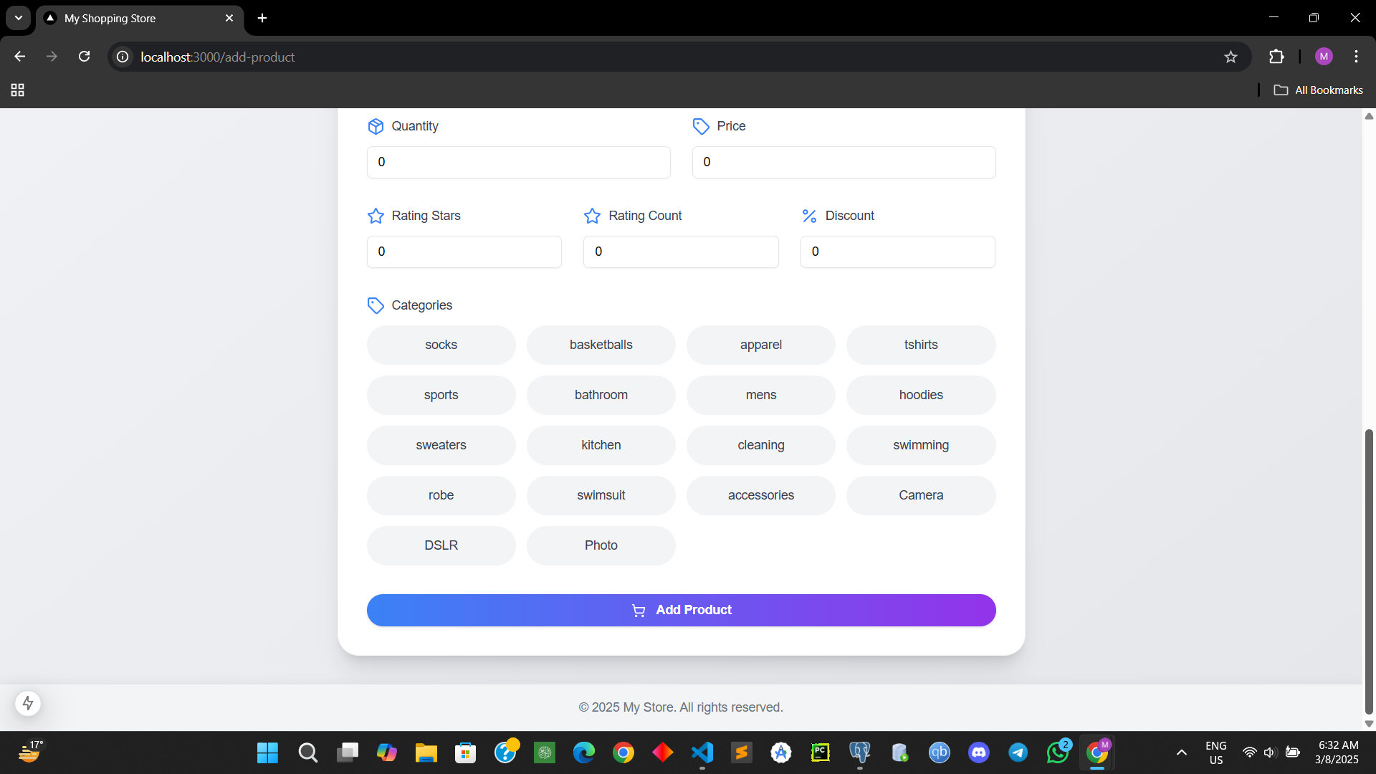

Slide 24
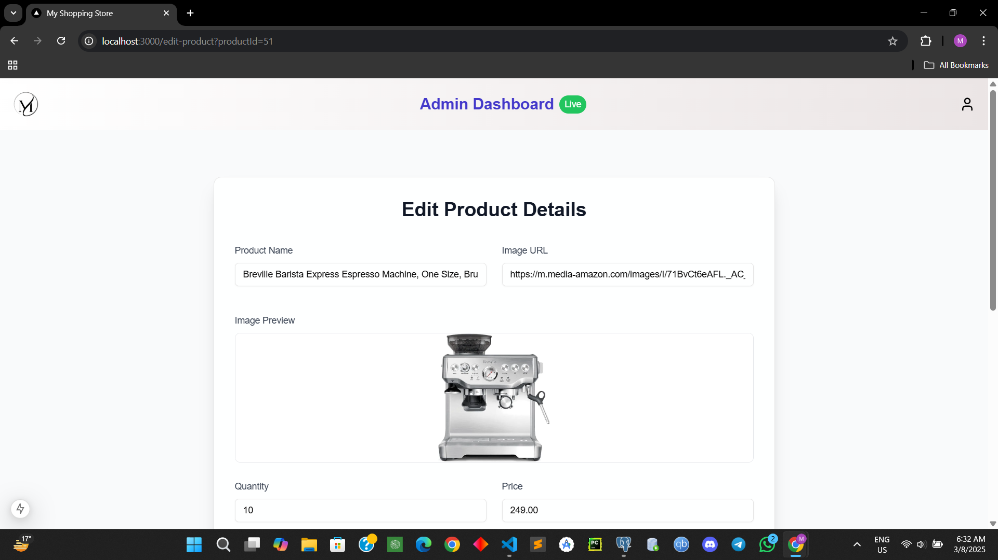
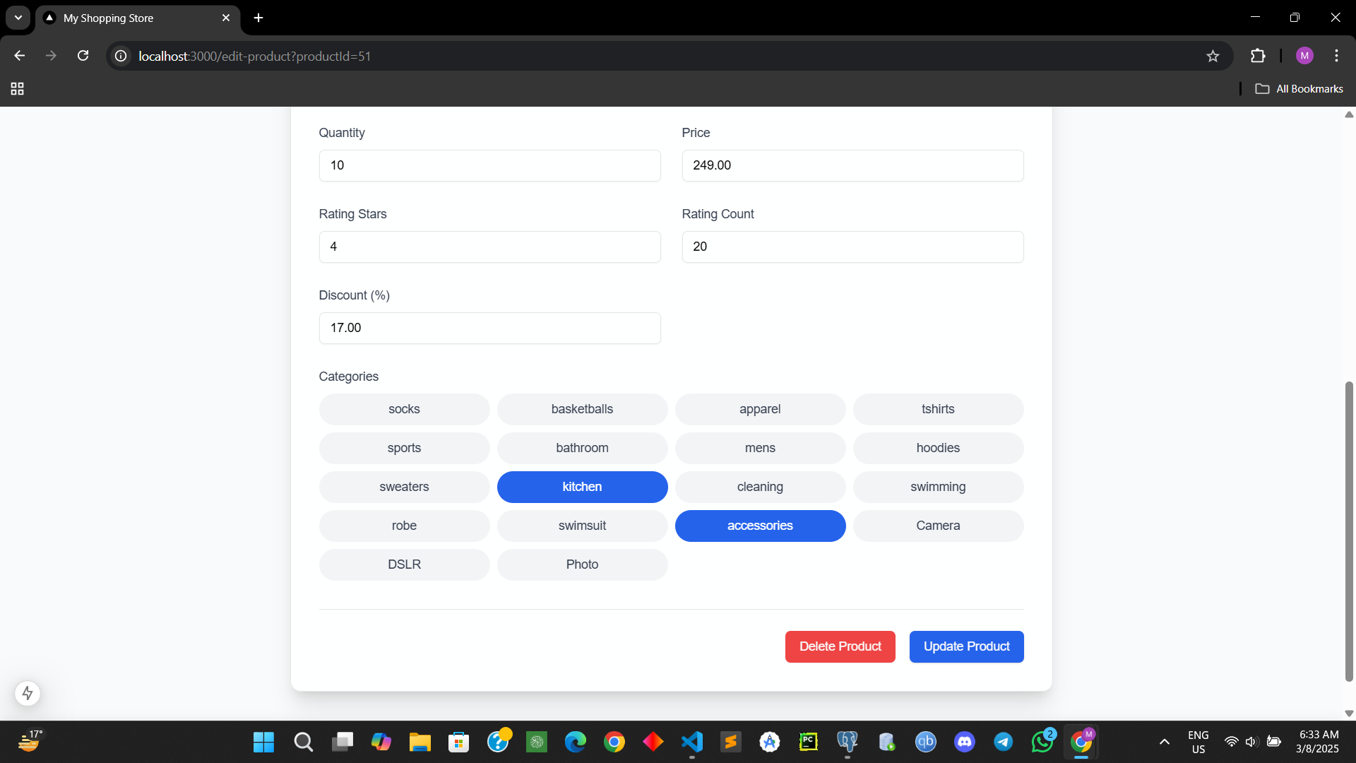
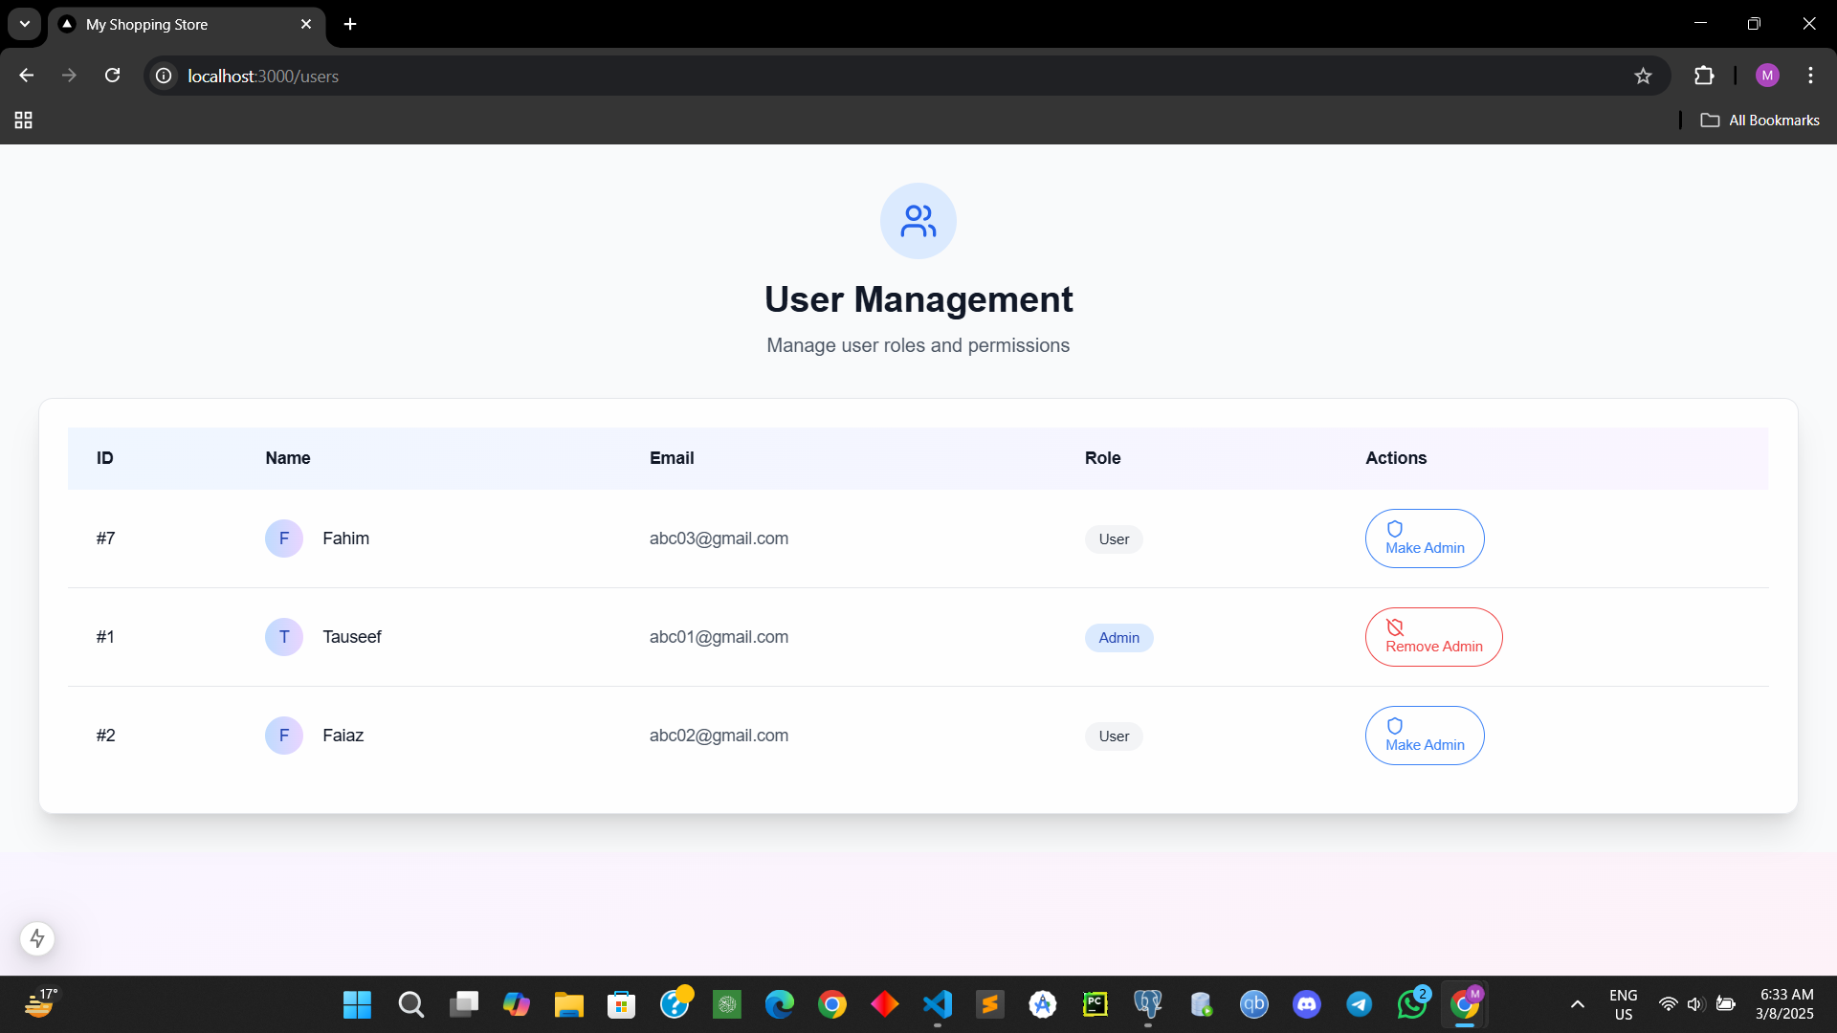
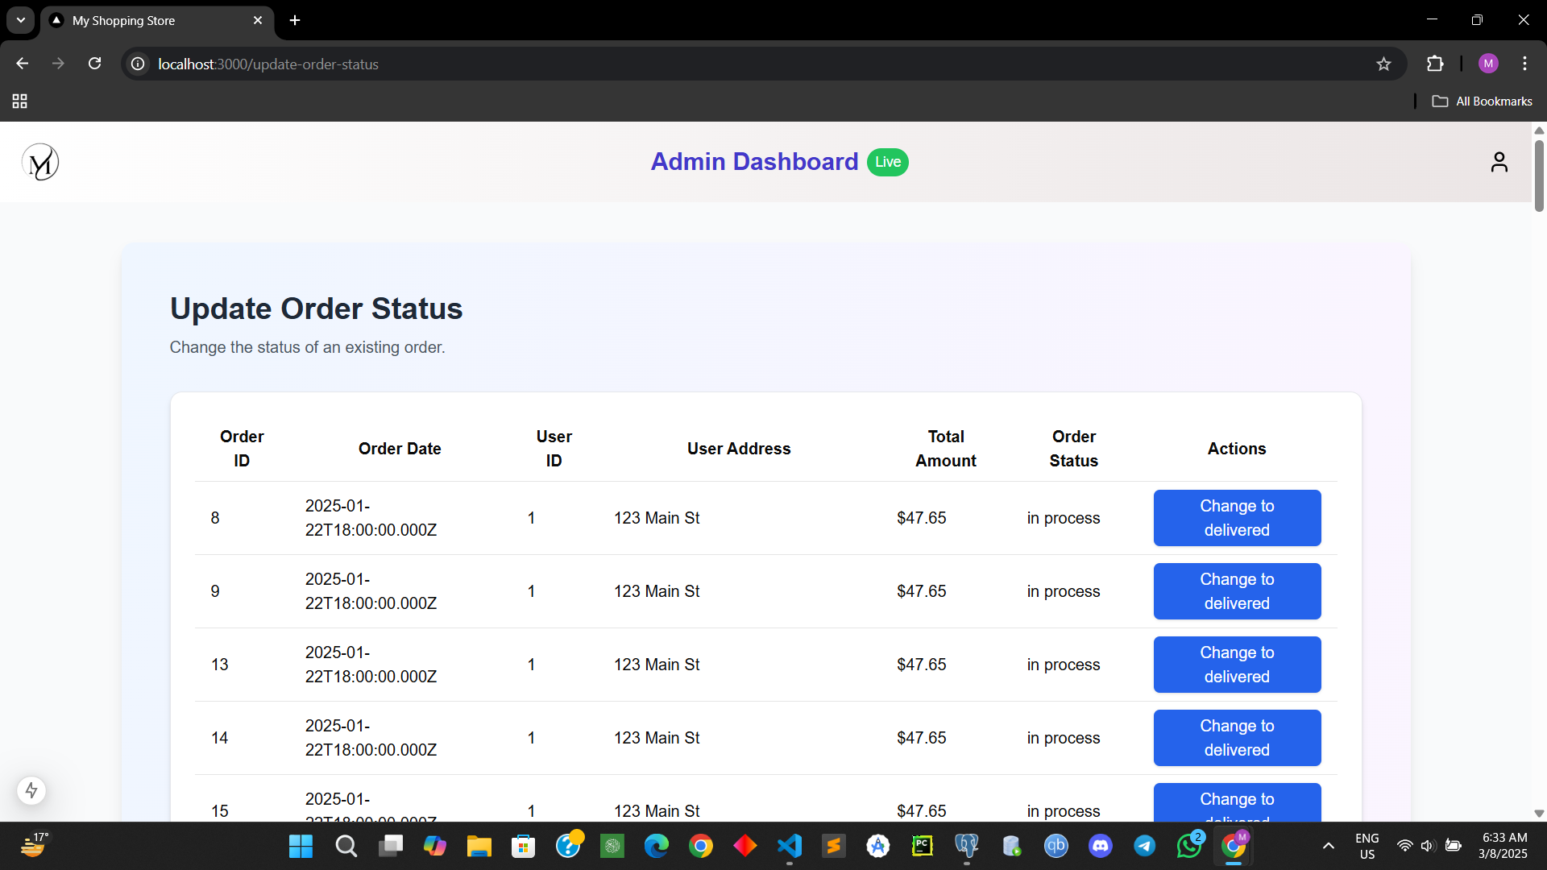

Slide 25
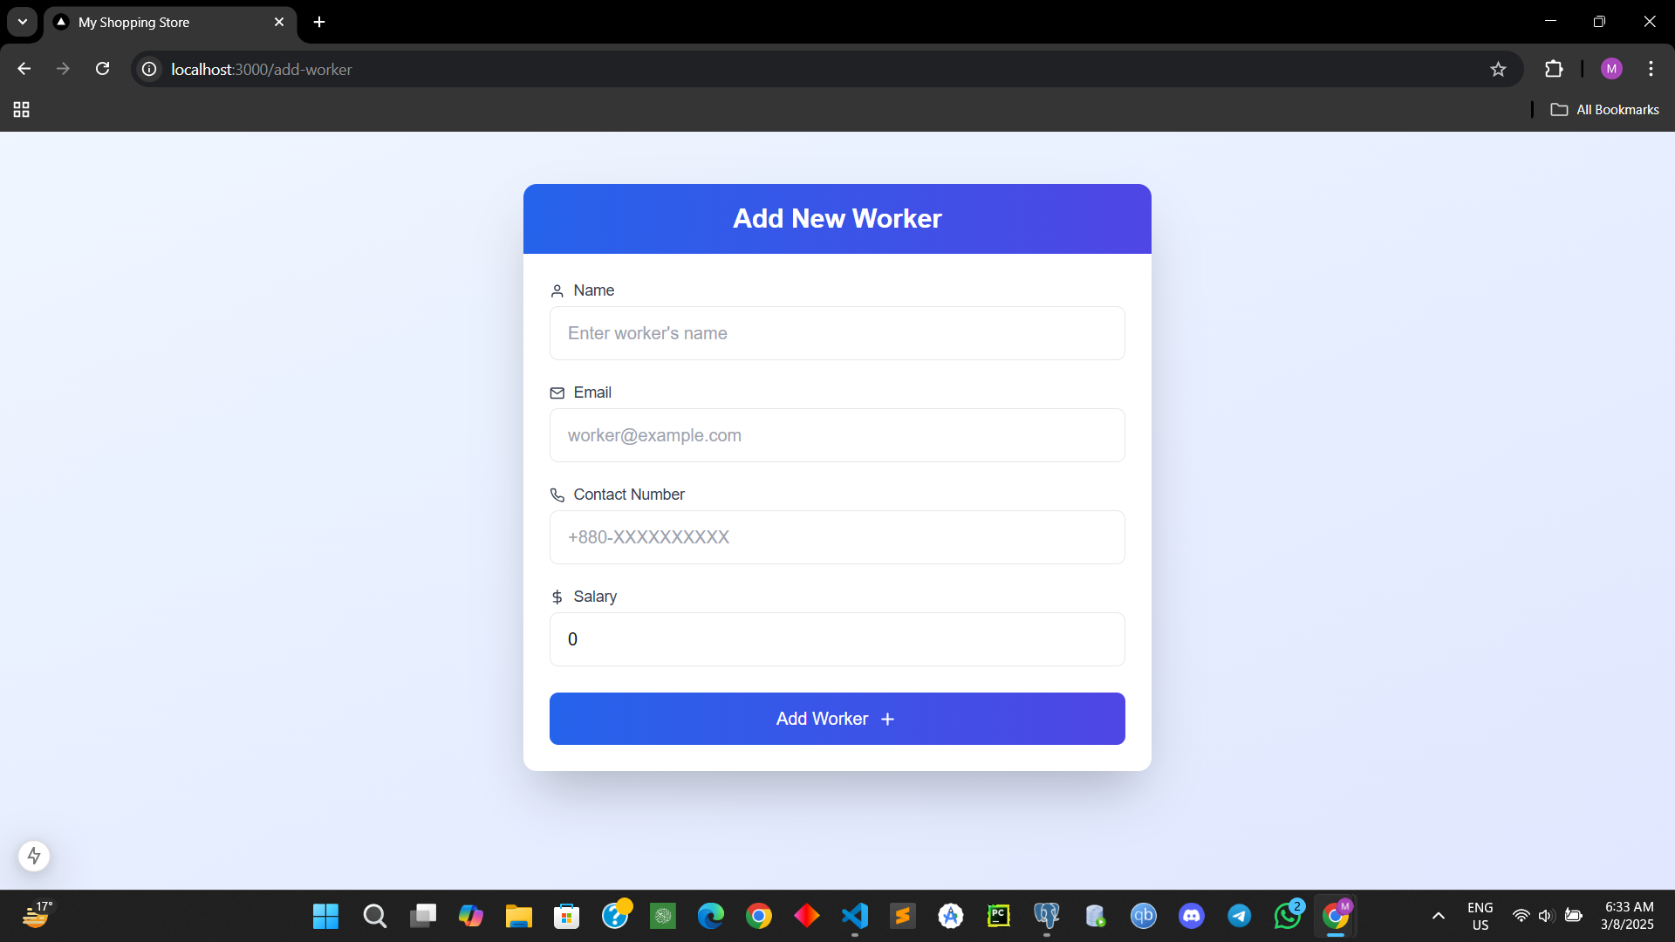
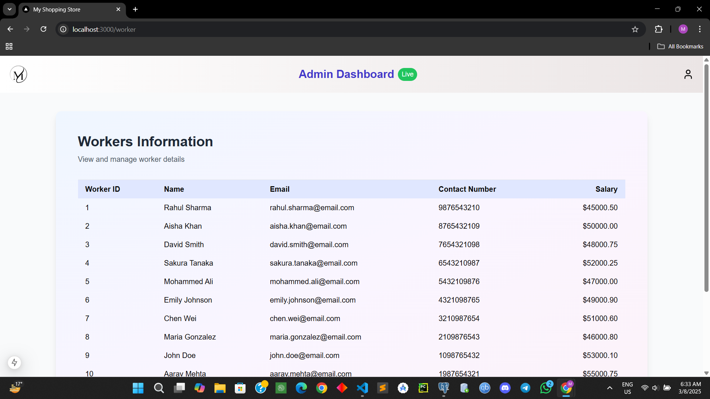
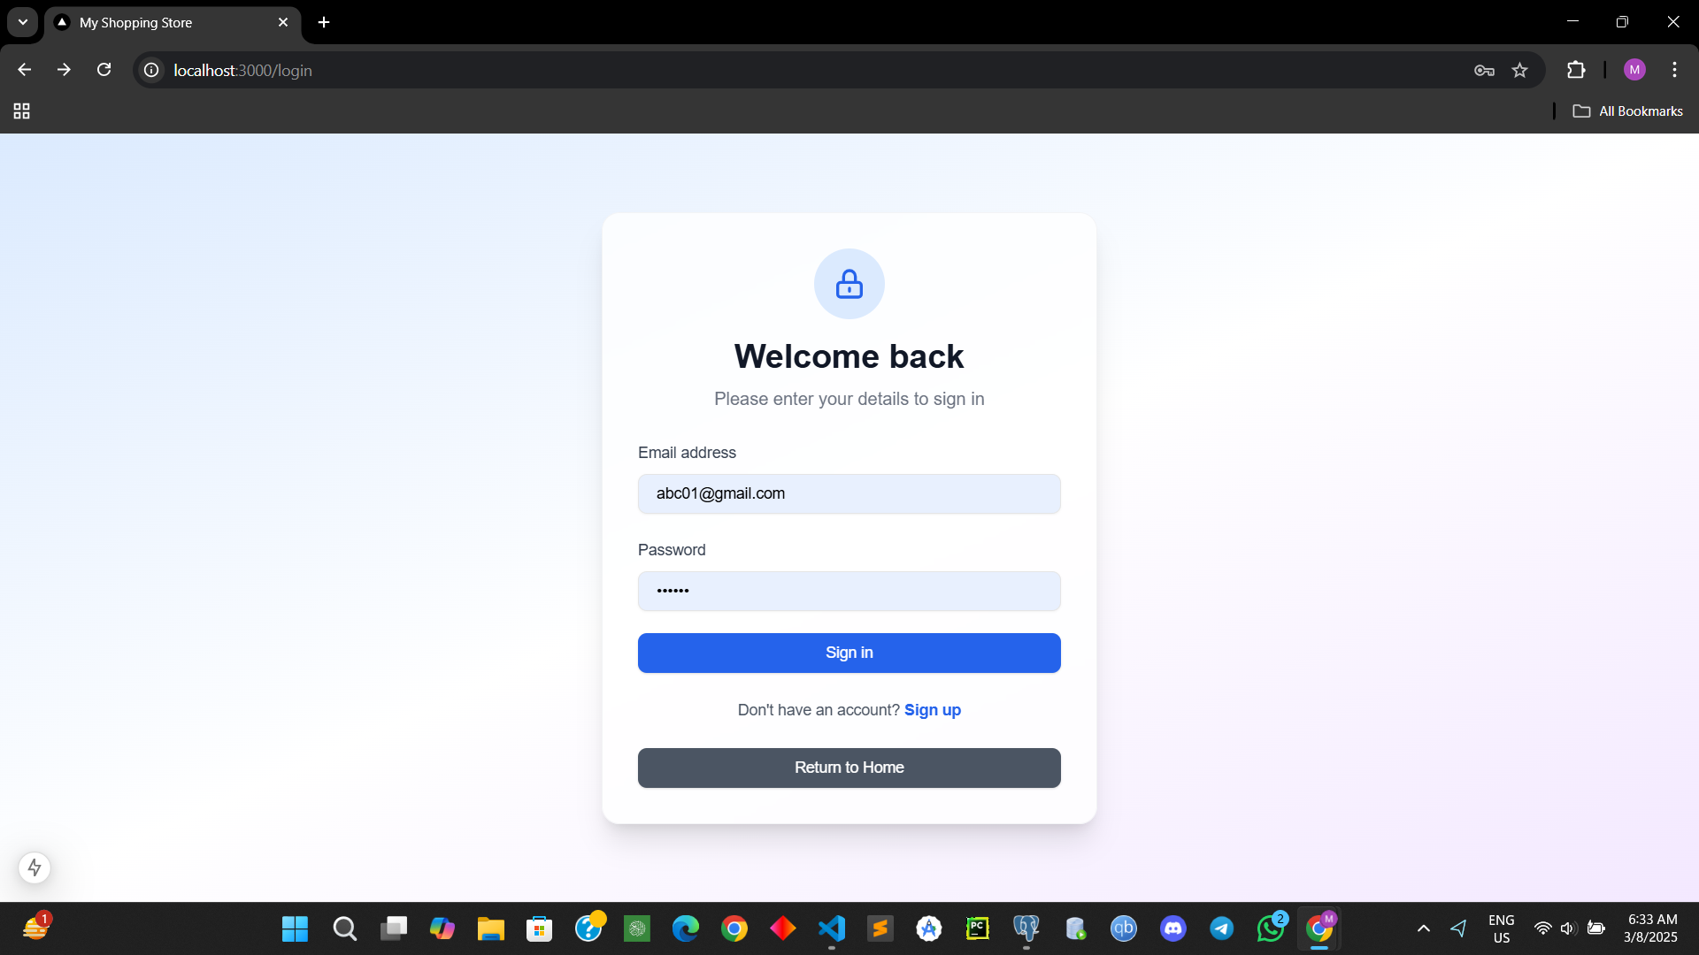
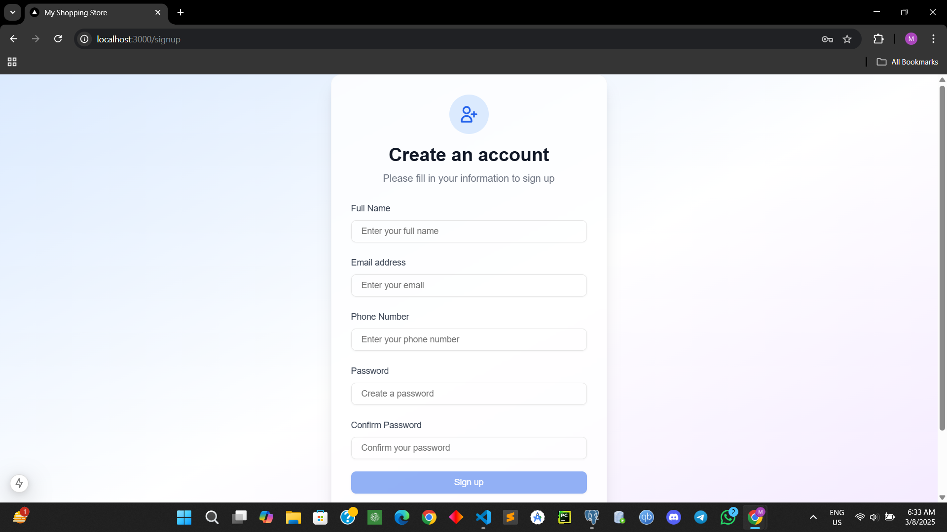

Slide 26
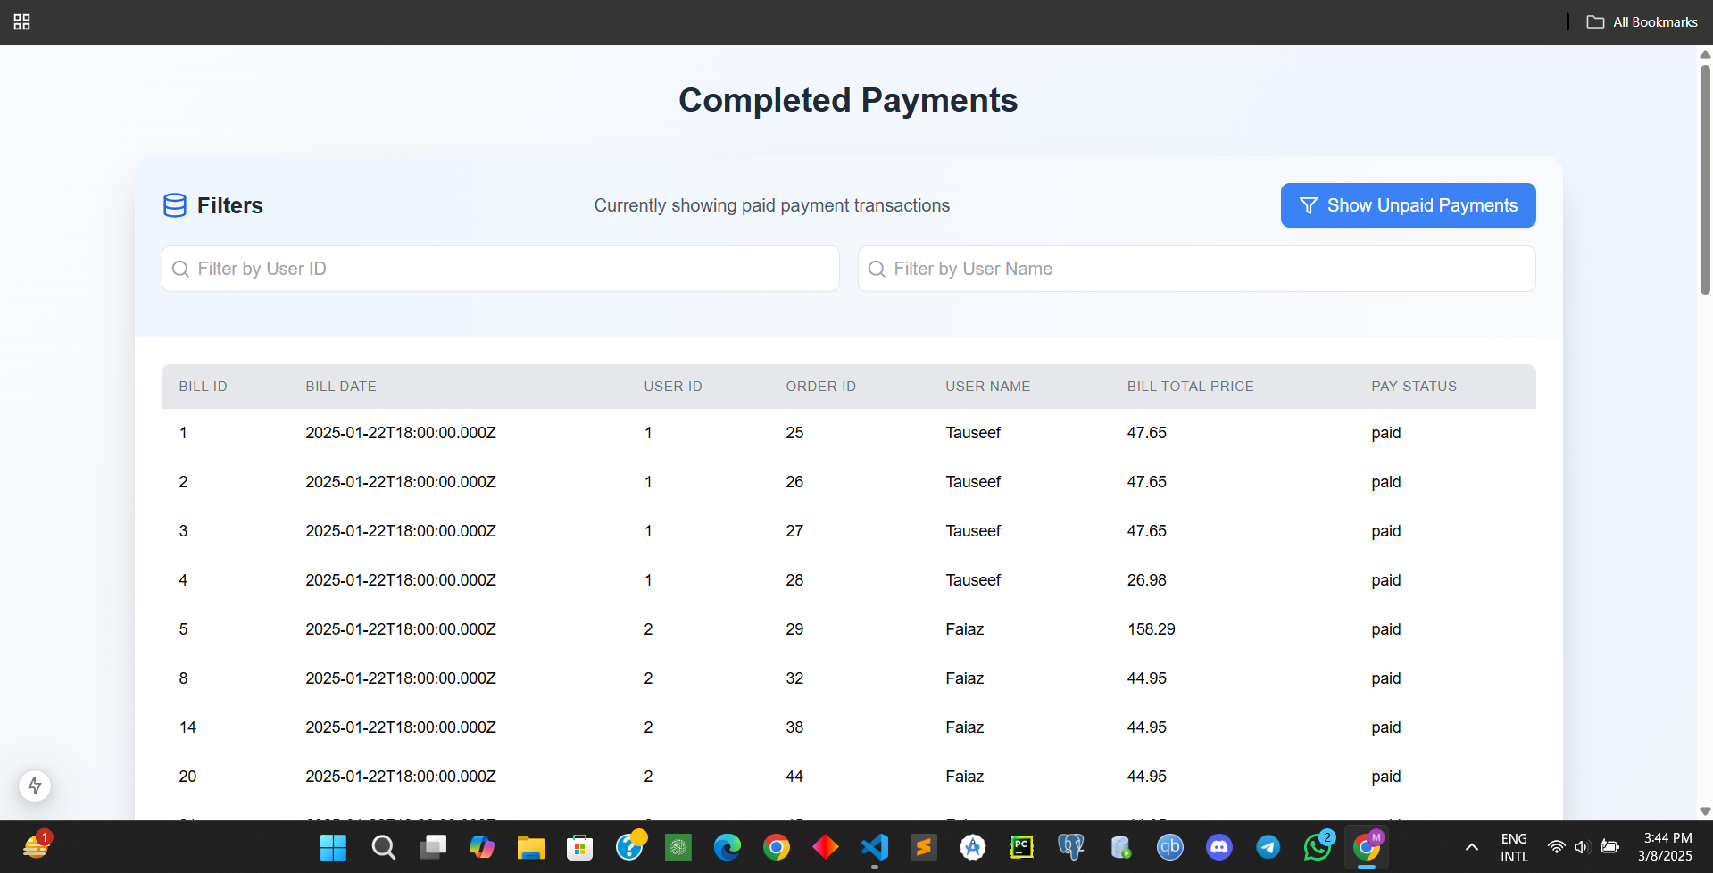
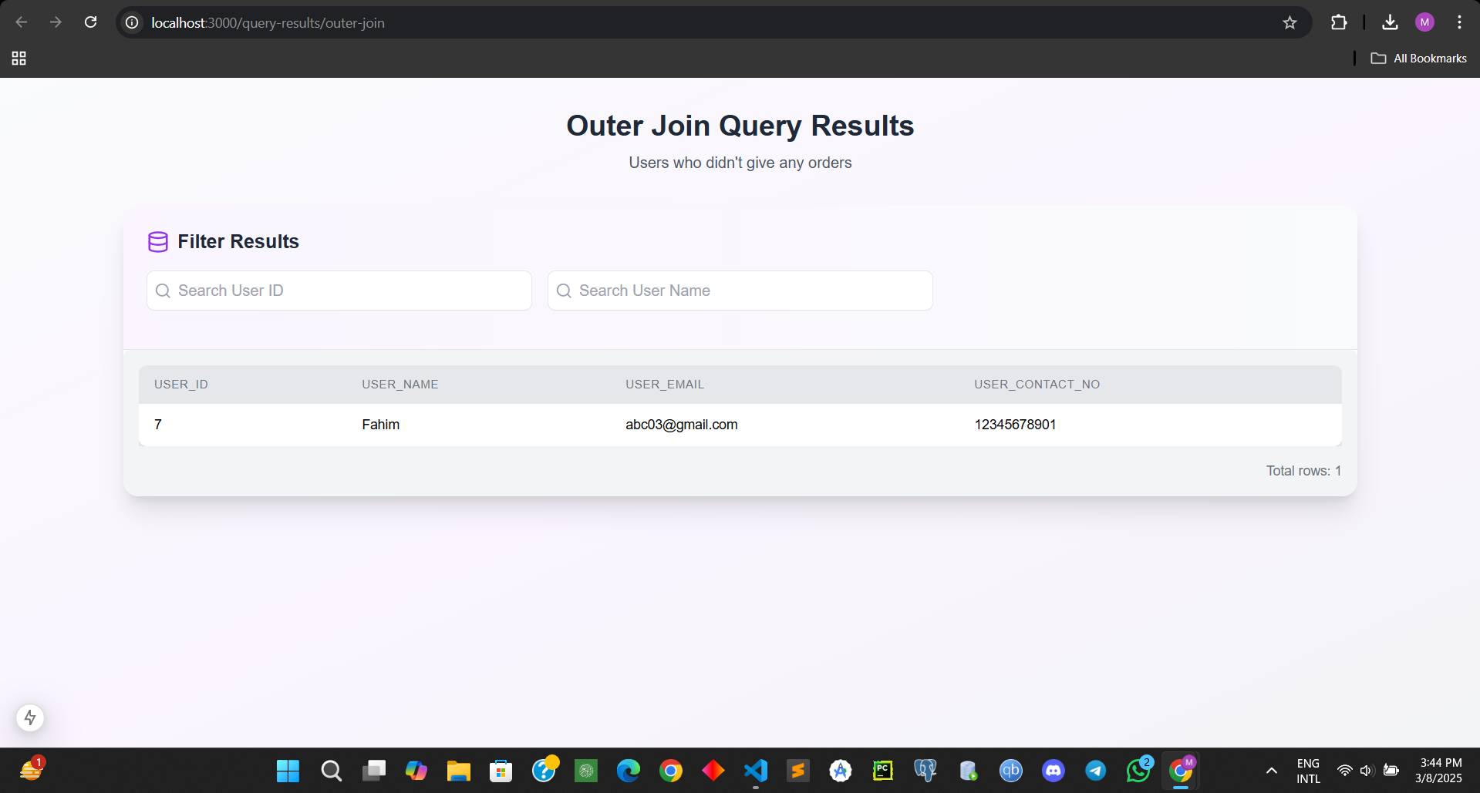
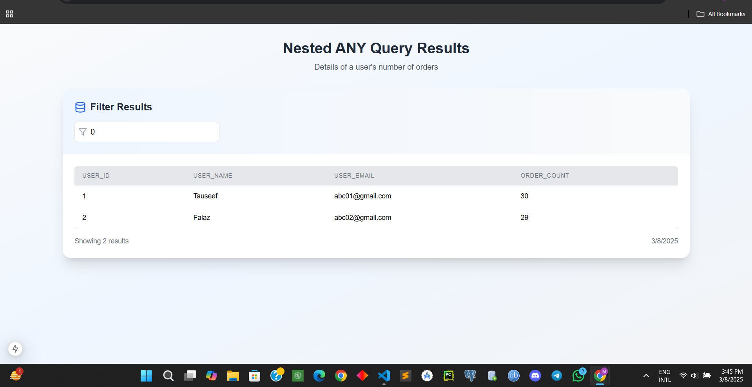
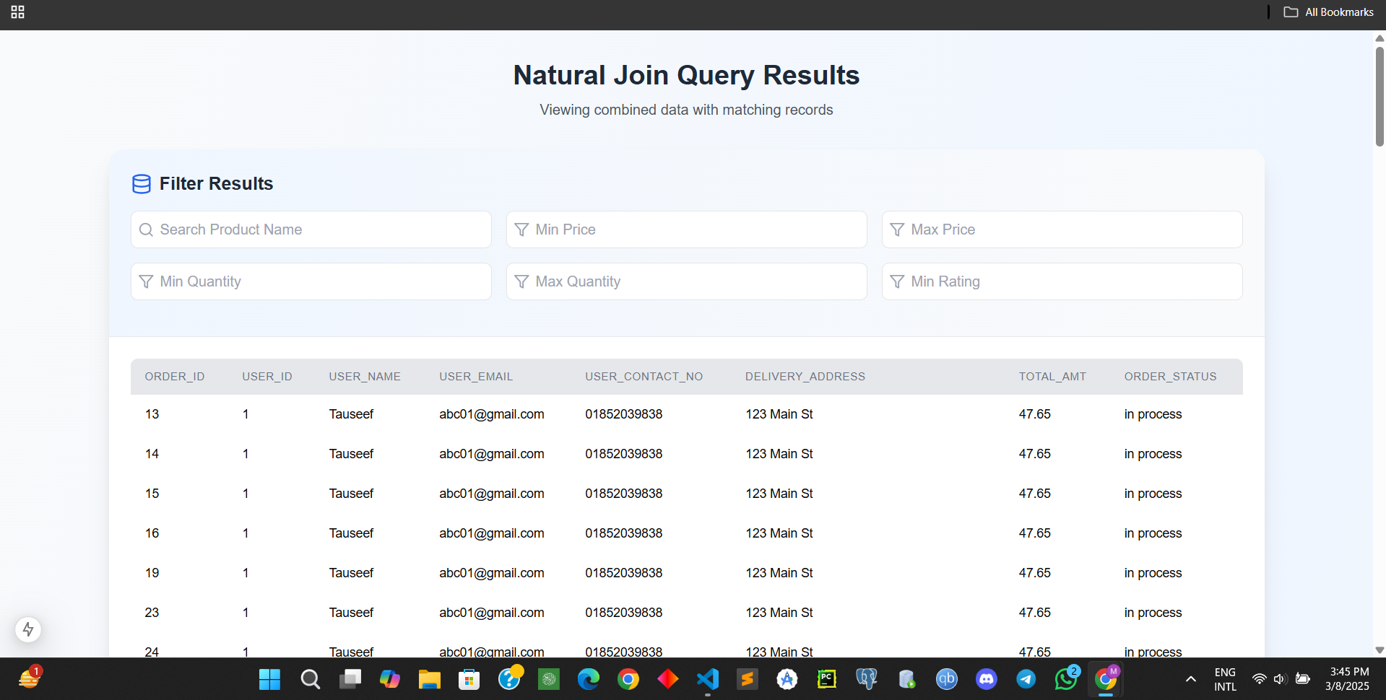

Slide 27
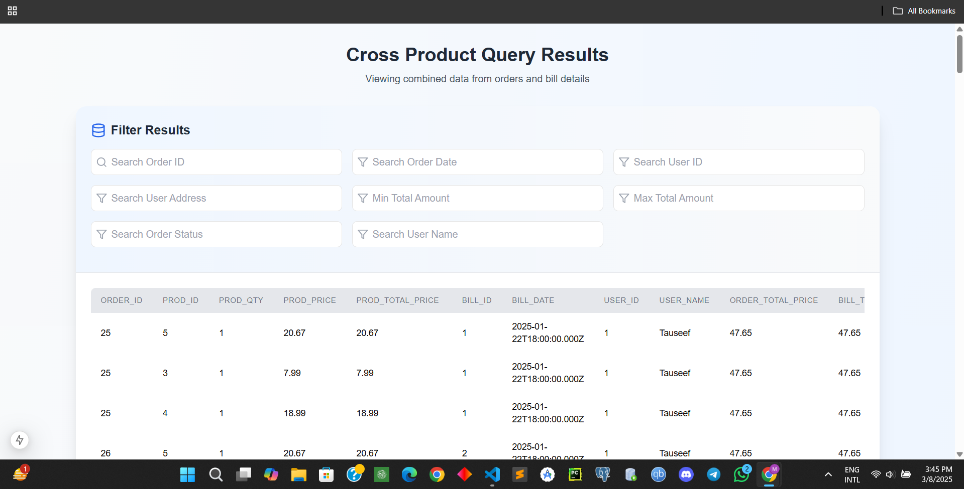
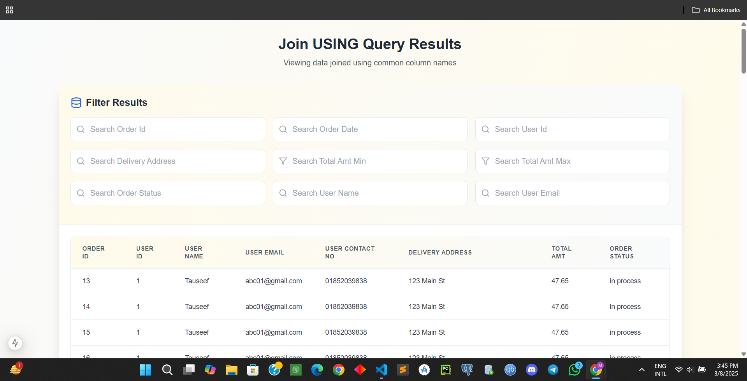
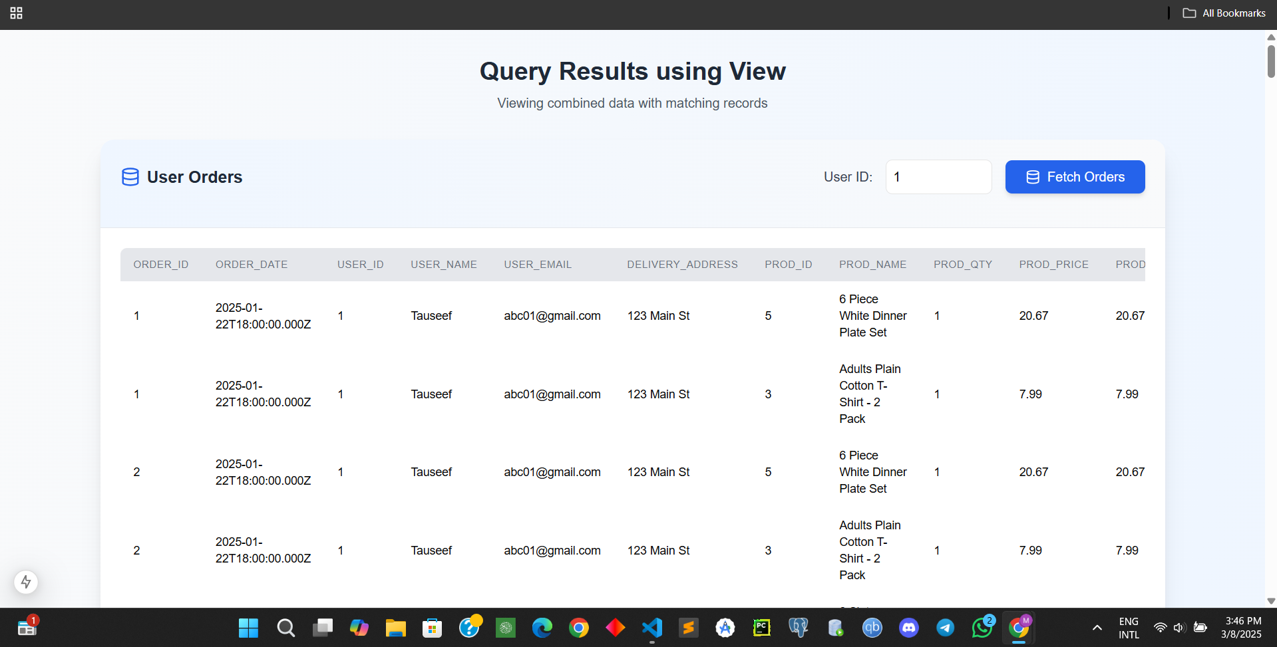
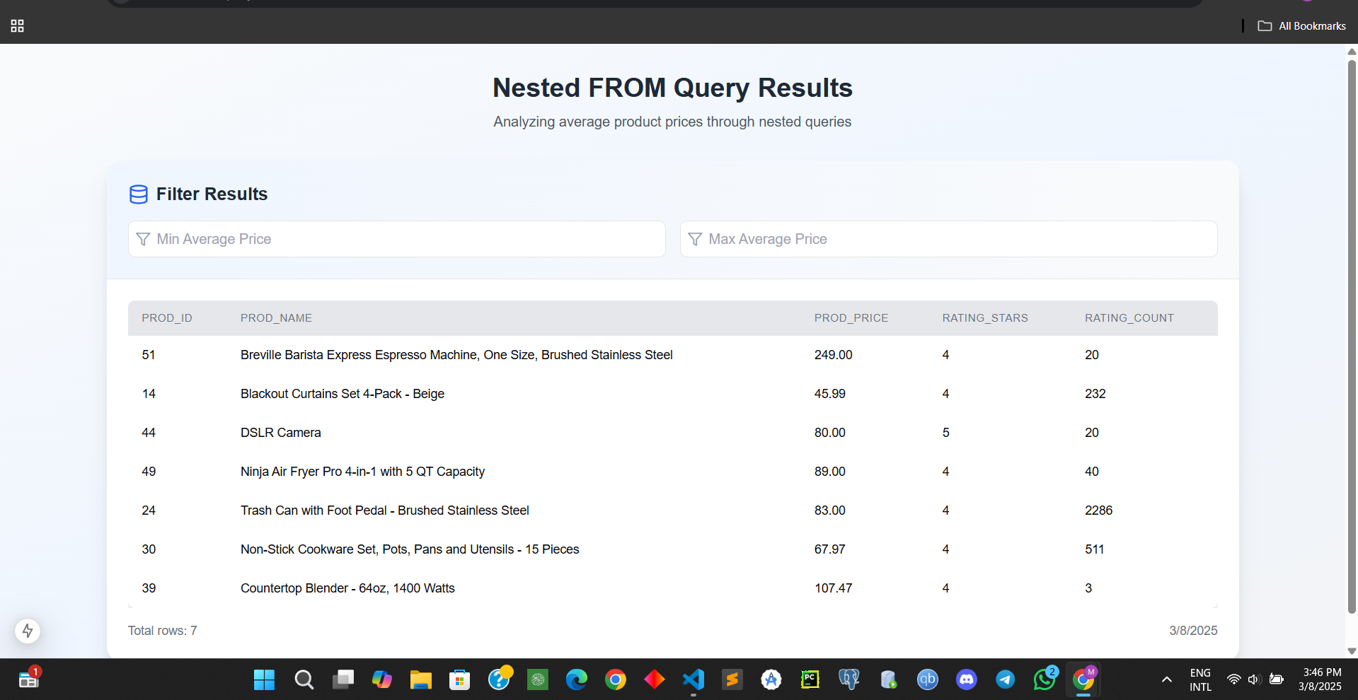

Slide 28
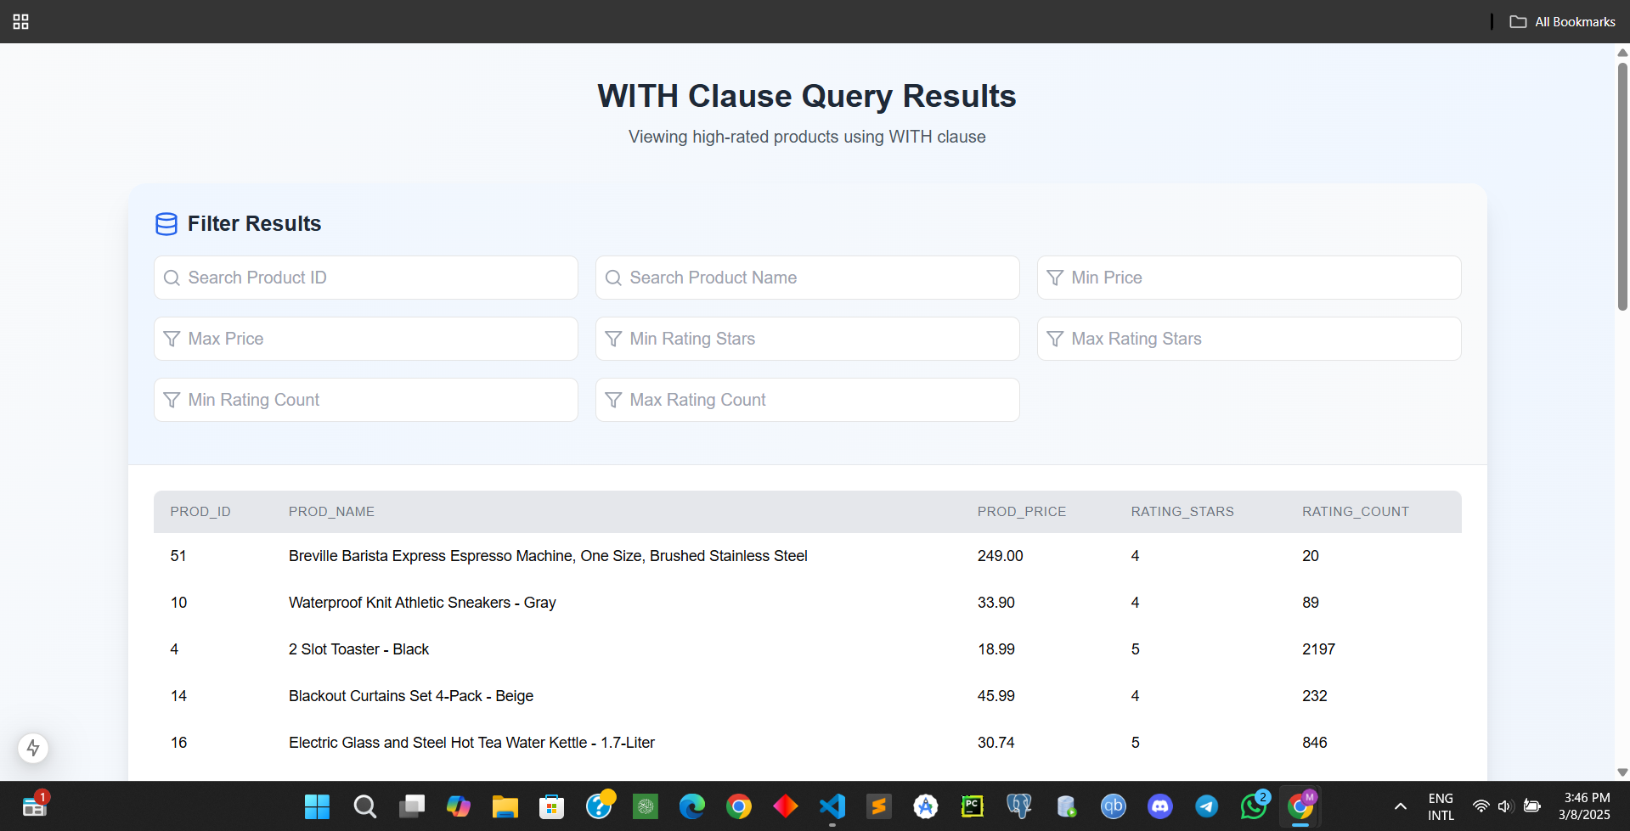
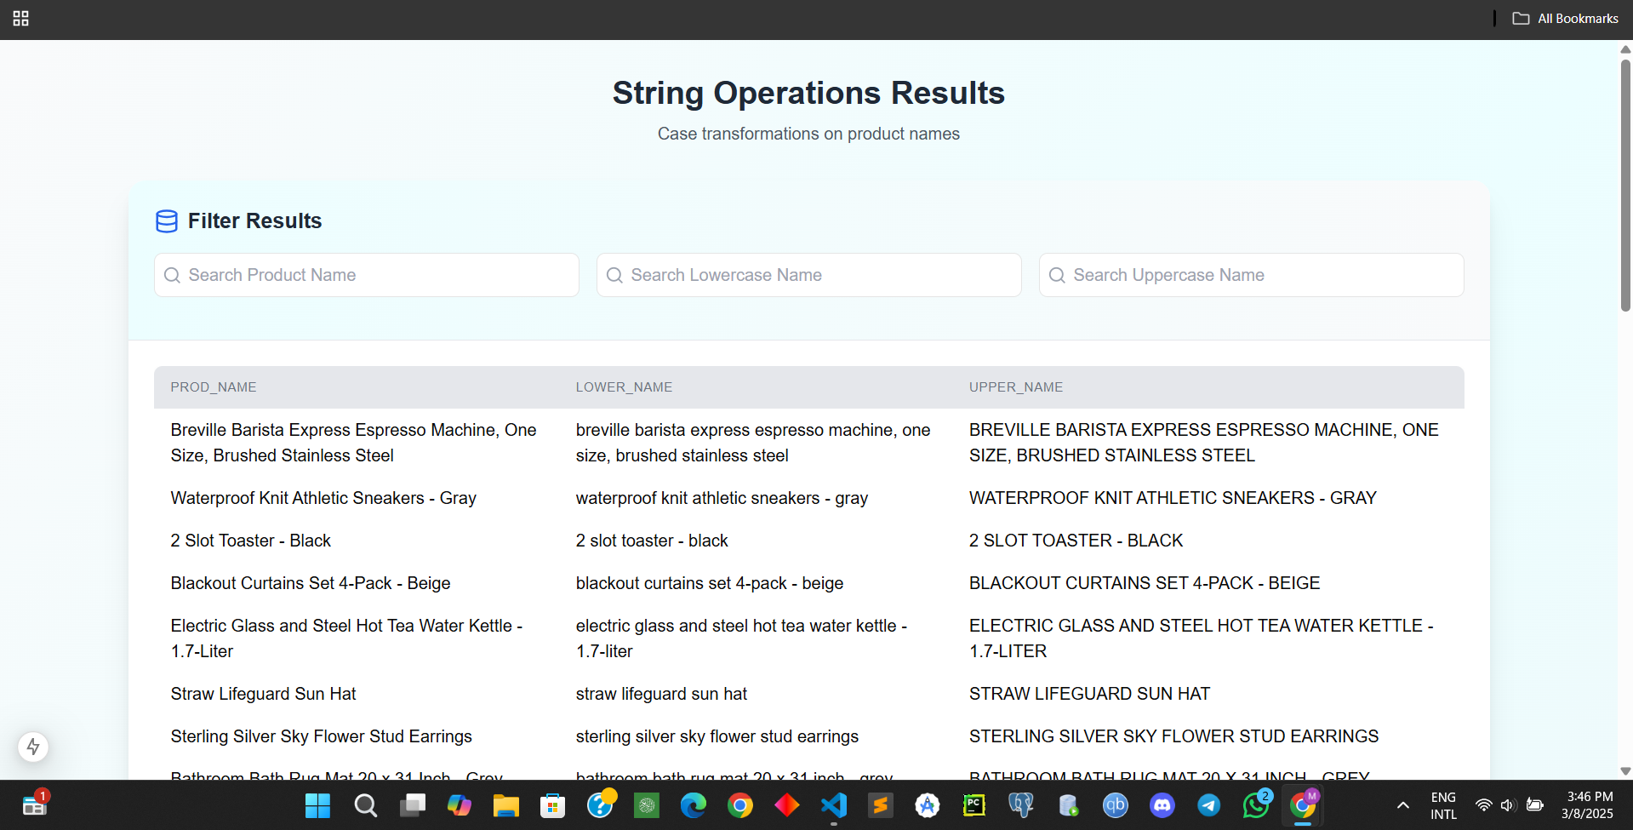
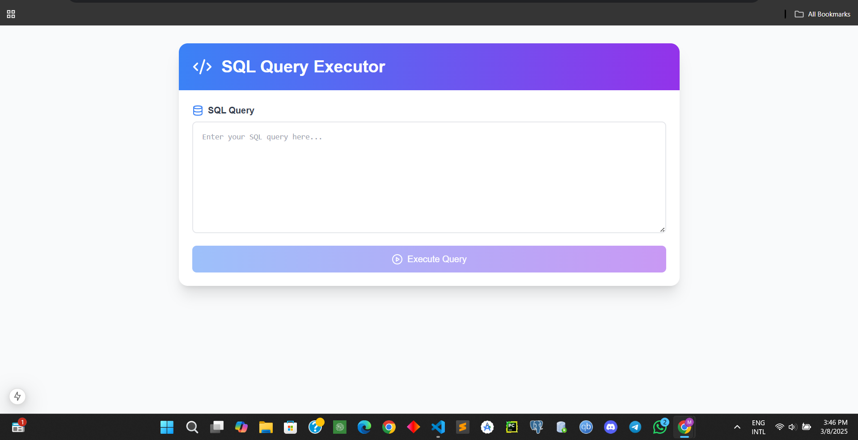

Slide 29
SQL Queries

Slide 30
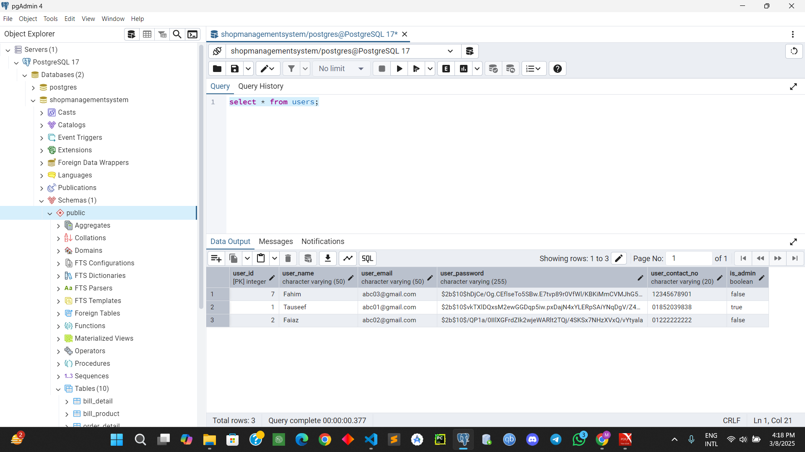
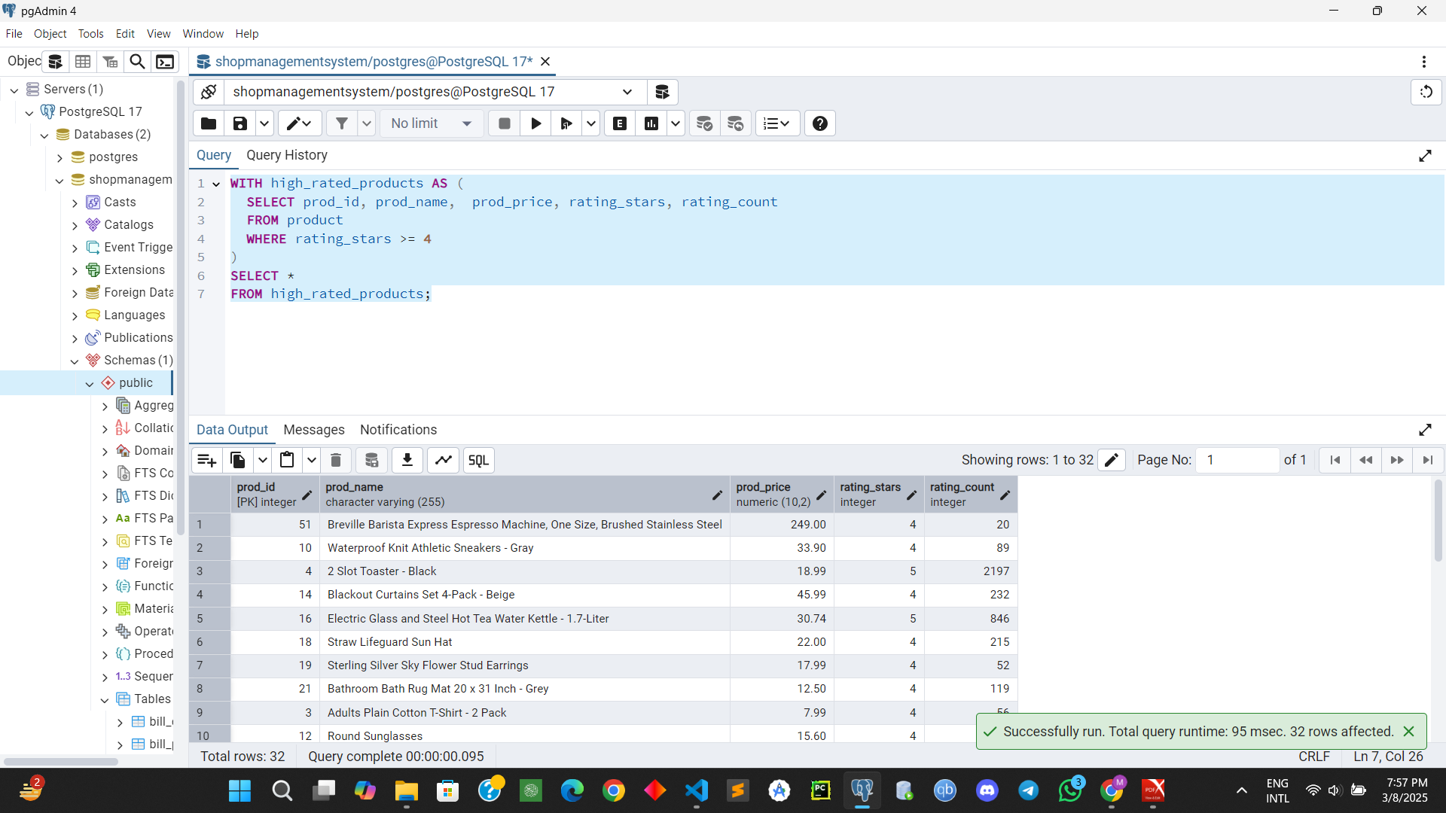
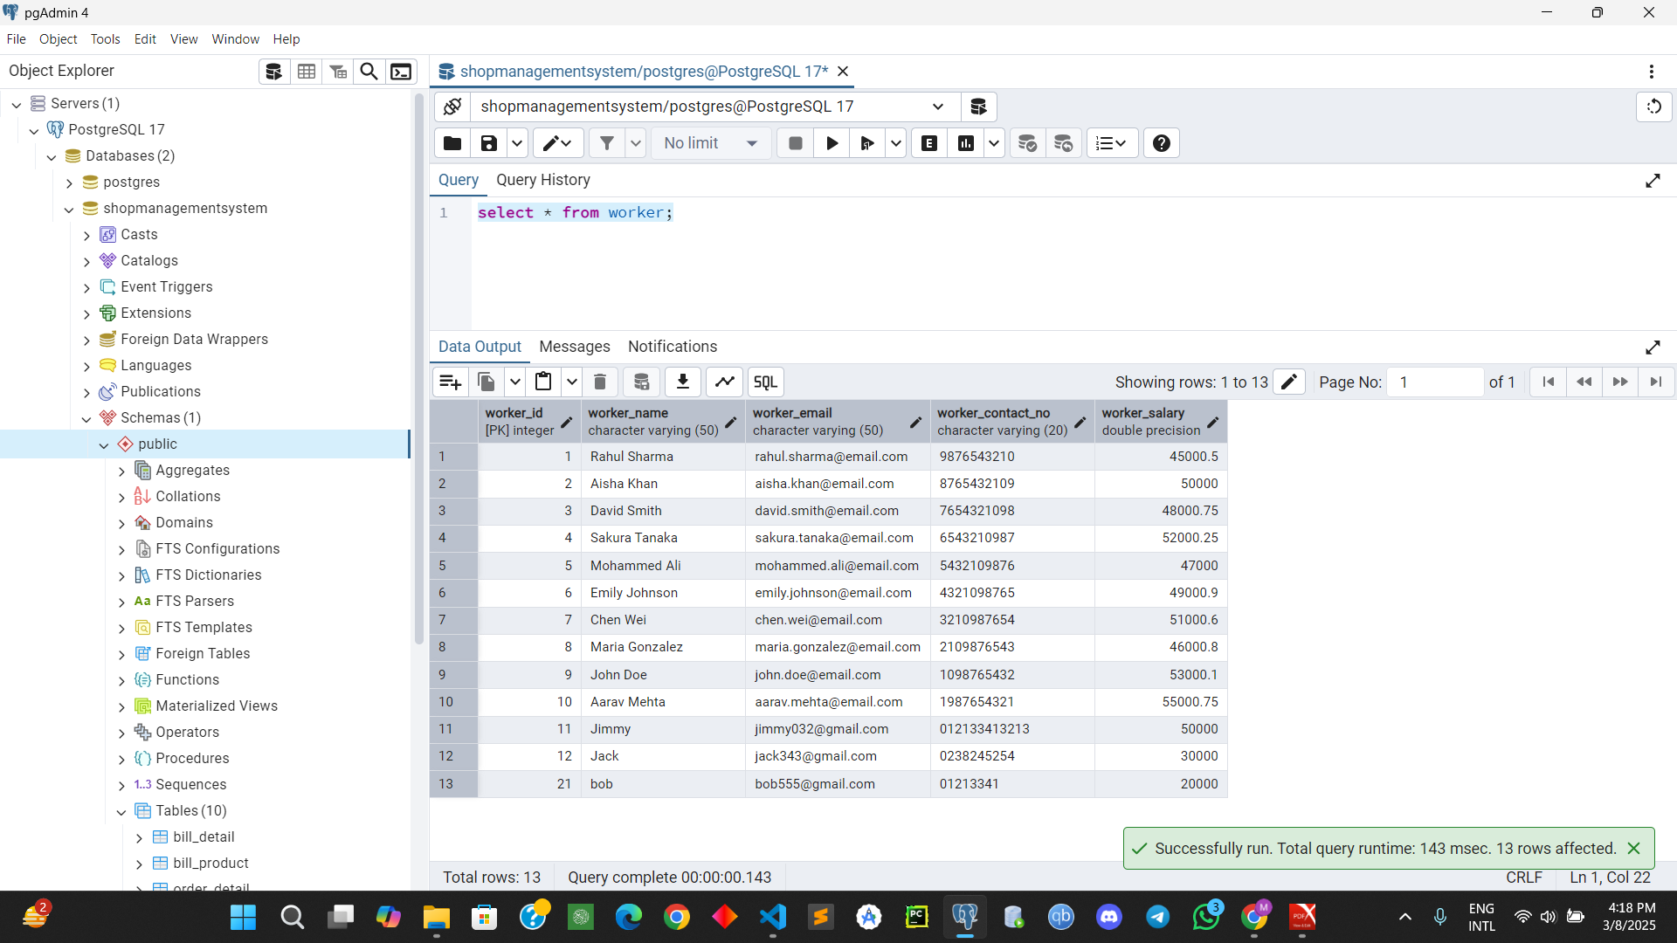
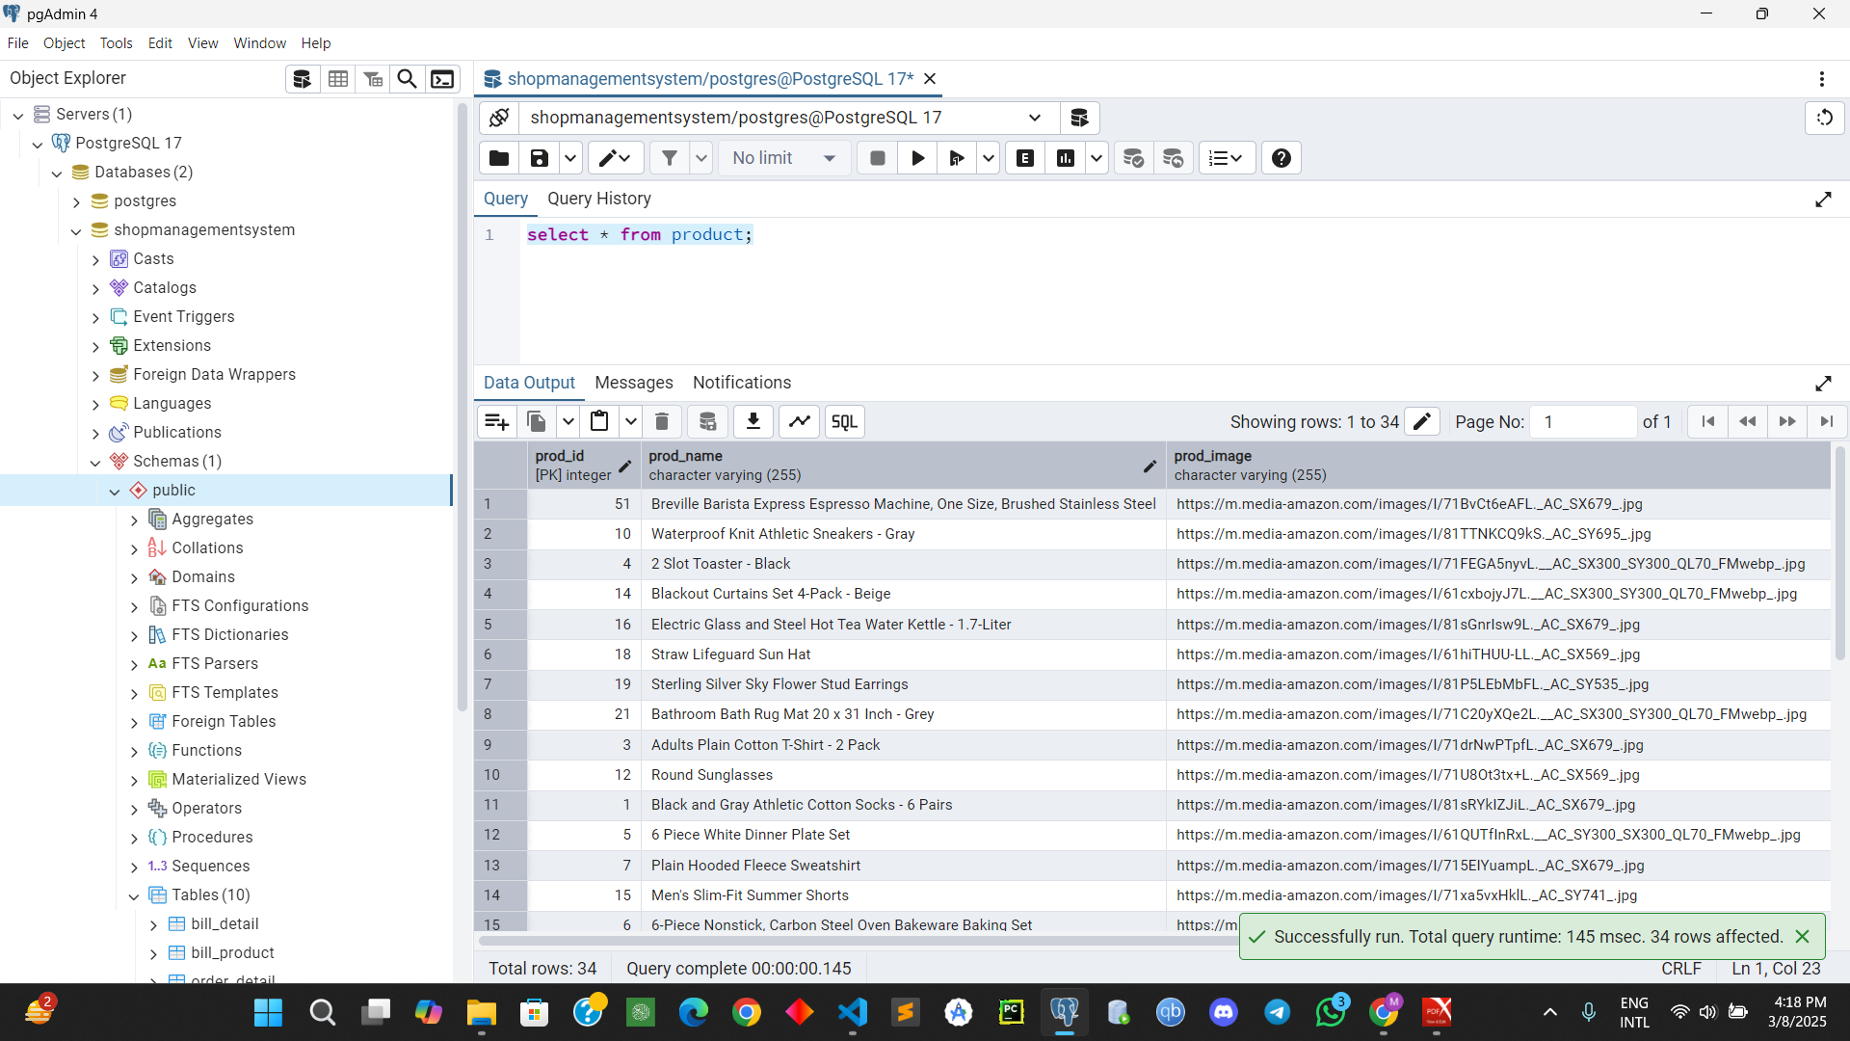

Slide 31
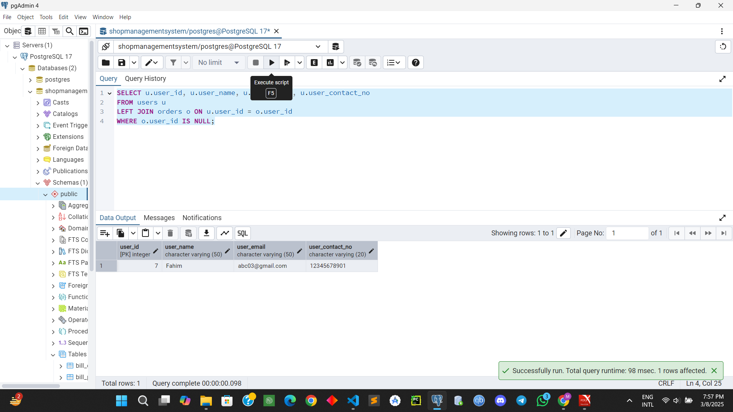
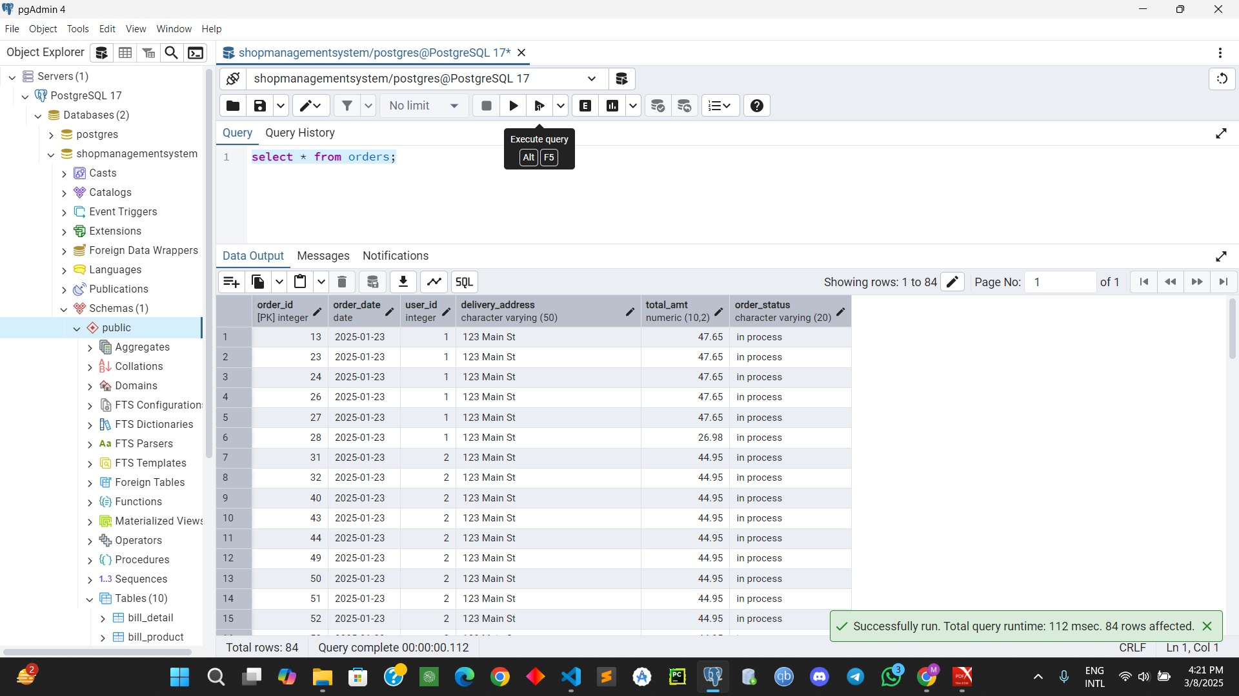



Slide 32





Slide 33





Slide 34





Slide 35



Slide 36




Slide 37
Some Special Features ……
All schemas are in 3rd normal form and BCNF except one.
Overview of recent sails, no of orders per user, regular vs returned orders are shown in colorful graph
User Friendly Interface
Apart from the default queries, option to write and run any SQL query involving the schemas is provided.

Slide 38
THANK YOU !

